Slide 1
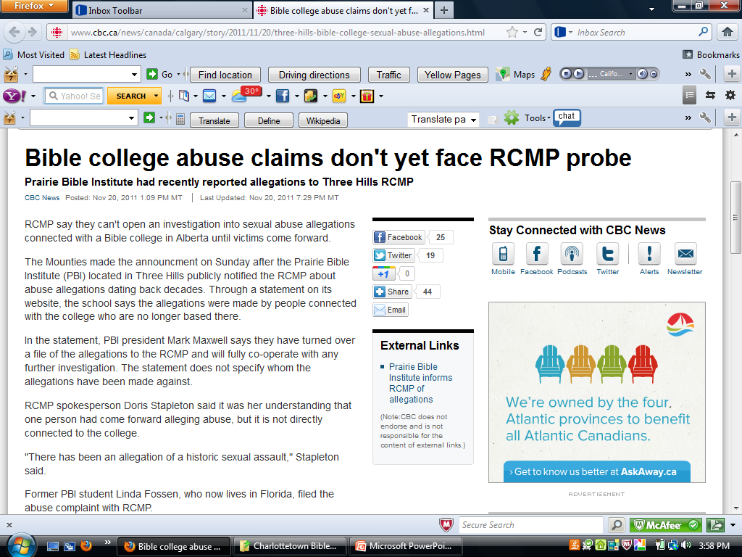

Slide 2
Plan to Protect
Charlottetown Bible Chapel
Policies and Procedures Manual
for
Children, Youth, and Leaders

Slide 3
The Charlottetown Bible Chapel has a spiritual, moral and legal obligation to provide a safe environment for children participating in church programs that are under the auspices and authority of the church.

Slide 4
Child abuse is a criminal act as well as a violation of human conscience and dignity.
It is a violation of God’s moral law within the trusted context of relationship.

Slide 5
It is criminal behavior that causes emotional, physical and spiritual trauma to victims, and has destructive consequences for abusers.

Slide 6
The devastating effects on the credibility of the church ministry and the name of Christ make it essential that the church take all appropriate steps to prevent abusive incidences from occurring.

Slide 7
Everyone who teaches, helps, or cares for children and/or youth under the auspices of the Charlottetown Bible Chapel is required to follow the guidelines and procedures as defined in this document.

Slide 8
The Trustees and Elders of the Charlottetown Bible Chapel have reviewed and adopted these guidelines and procedures as official policy.

Slide 9
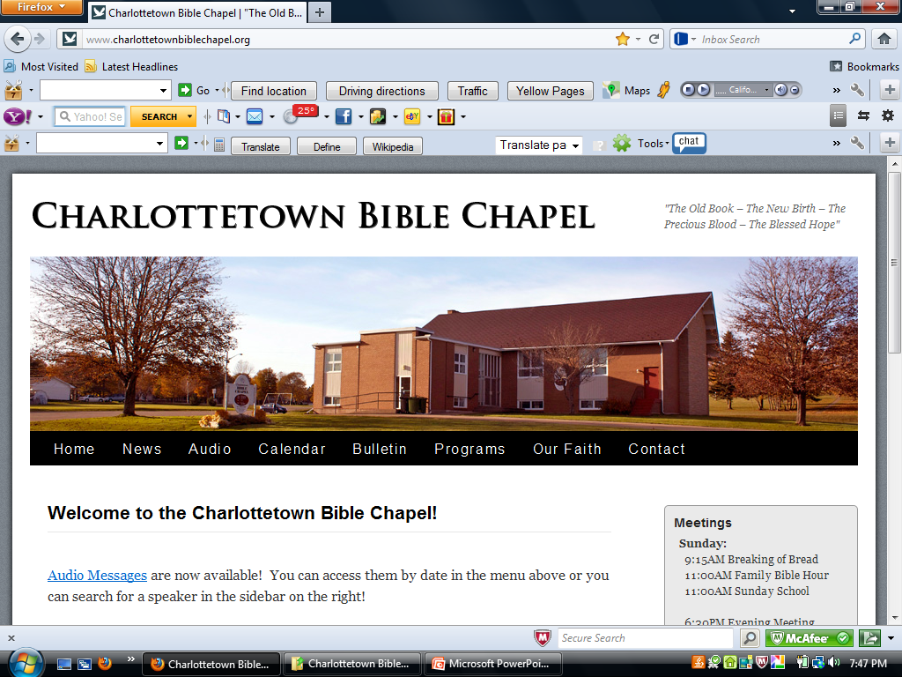

Slide 10
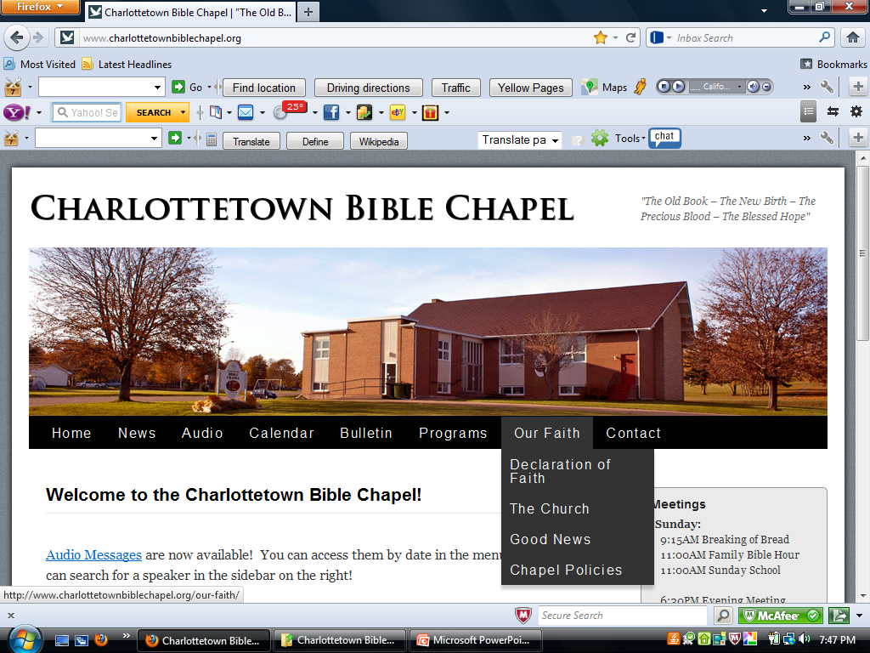

Slide 11
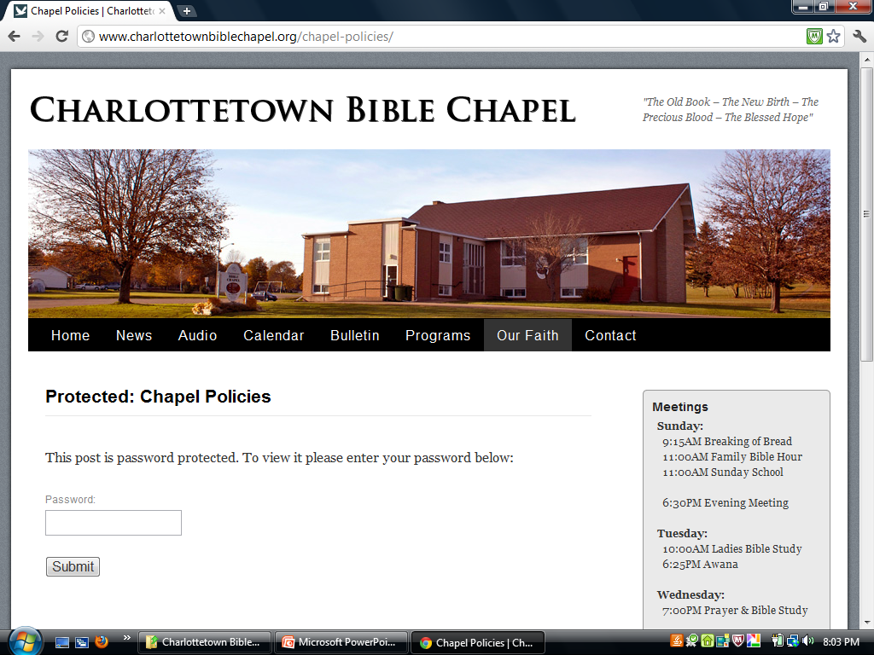

Slide 12
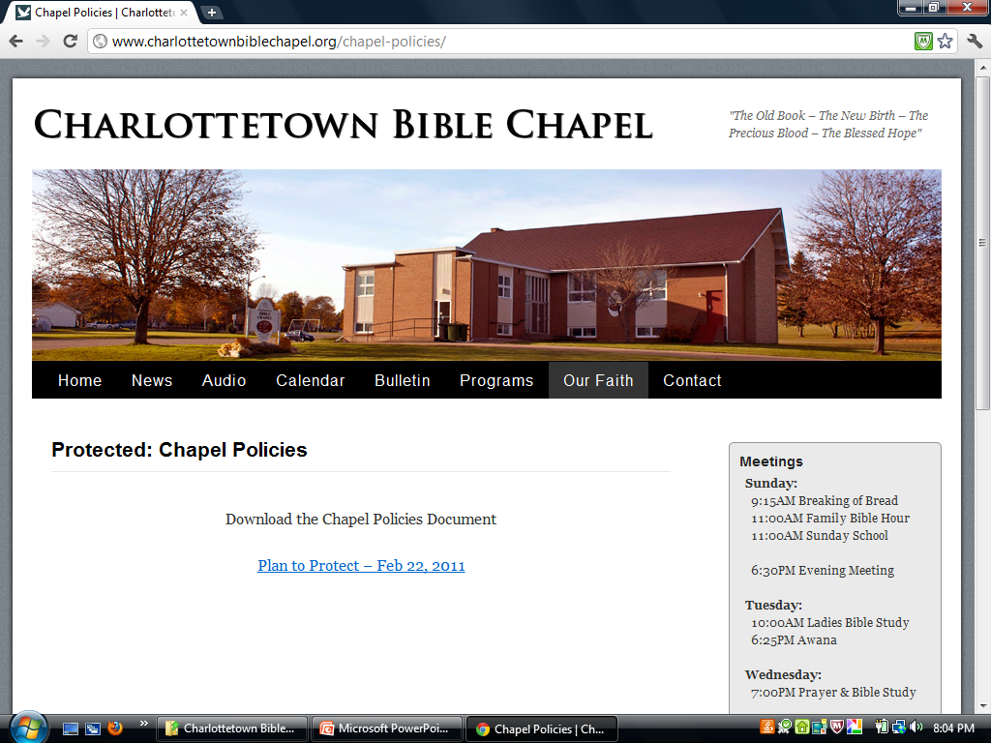

Slide 13
Criminal Record Check
All volunteers are required to have their own criminal record checks done, for any position involving work with children or youth.

Slide 14
Two Adult Rule
Where possible two adults should be present during any children’s activity. This rule reduces the risk of child molestation, and also reduces the risk of false accusations of molestation by individuals seeking a quick legal settlement.

Slide 15
Open Door
When it is necessary that only one adult leader be in a room with one child the door of that room must remain open.

Slide 16
What is Child Abuse?
It can be physical, emotional or sexual.
All child abuse involves the misuse of power.
Misuse of power takes place when people take advantage of the authority or power they have over vulnerable people.

Slide 17
What is child abuse?
Vulnerable people include adults with physical or mental disabilities and children. (Note: “child” means a person actually or apparently under the age of sixteen, and includes a disabled person actually or apparently under the age of nineteen.)

Slide 18
What is Child Abuse?
Physical Abuse is using physical force or action that results, or could result, in injury to a child or youth.

Slide 19
What is Child Abuse?
Emotional Abuse is a pattern of hurting a child’s feelings to the point of damaging their self-respect.

Slide 20
What is Child Abuse?
Sexual Abuse occurs when a child or youth is used by somebody else for sexual stimulation or gratification.

Slide 21
Physical signs may include
lacerations and bruises
Nightmares
irritation, pain or injury to the genital area
difficulty with urination
torn or bloody underclothing
discomfort when sitting
venereal disease

Slide 22
Behavioral signs may include
anxiety when approaching chapel or nursery area
nervous or hostile behavior toward adults
sexual self-consciousness
“acting out” sexual behavior
withdrawal from chapel activities and friends

Slide 23
Verbal signs may include the following statements:
I don’t like (names a particular person)
(Particular person) does things to me when we’re alone
I don’t like to be alone with (particular person)
(Particular person) fooled around with me

Slide 24
Incident Reporting Procedures
Any person who has reasonable grounds to believe that a child (or children) is in need of protection is legally required to report the matter to a social worker in the local office of the Child Protection Department of Family and Community Services

Slide 25
Incident Reporting Procedures
A person who knowingly fails to report in these circumstances is in violation of the law and may be found to have committed an offense.

Slide 26
Responding to the Child
When the child first comes to you, be sure to take his or her word seriously.
Don’t deny the problem, but stay calm and listen to the child.

Slide 27
Responding to the Child
Give emotional support, reminding the child that he or she is not at fault.
Tell the child that he or she was right in telling you about the problem.

Slide 28
Responding to the Child
Do not promise the child you will not tell anyone.

Slide 29
Responding to the Child
Remember it is not your job to investigate or to determine if the child is being truthful!

Slide 30
Responding to an incident
If an incident comes to your attention all we ask you to do is to report it to your program leader and to document the incident.

Slide 31
Responding to an incident
Confidentiality is very important
In these matters it is important to keep the information restricted to those who need to be advised, therefore, all suspicions of abuse should be directed only to the Program leader, who will then contact an Elder.

Slide 32
“It is always tragic when children are abused or exploited. The Charlottetown Bible Chapel is aware of the ever growing nature of child abuse. We have taken careful precautions to protect the children entrusted to our care. We are distressed by any accusation of child abuse. We will do everything in our power to address any needs in this situation. For the welfare of those involved, all information has been directed to the Child Protection Department of Family and Community Services .

