Slide 1
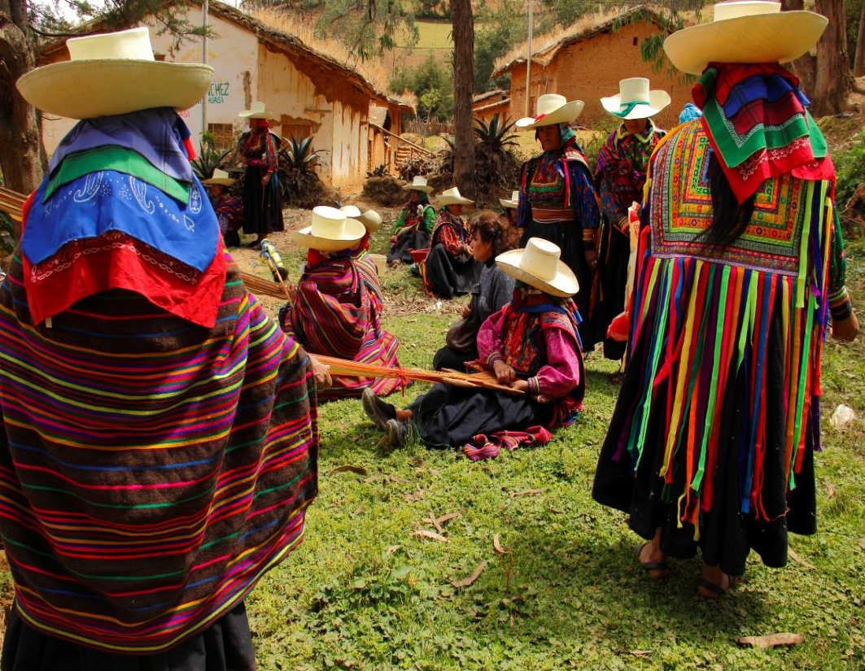
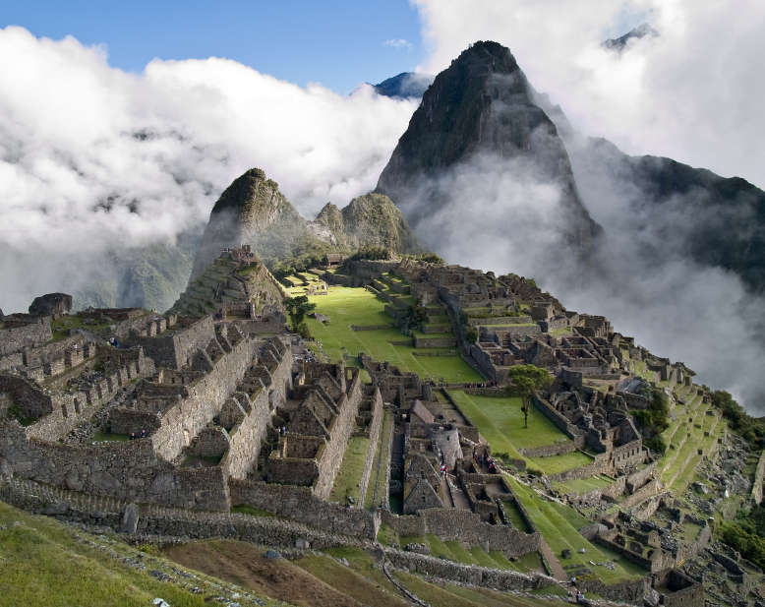
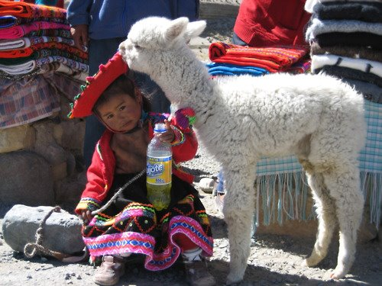
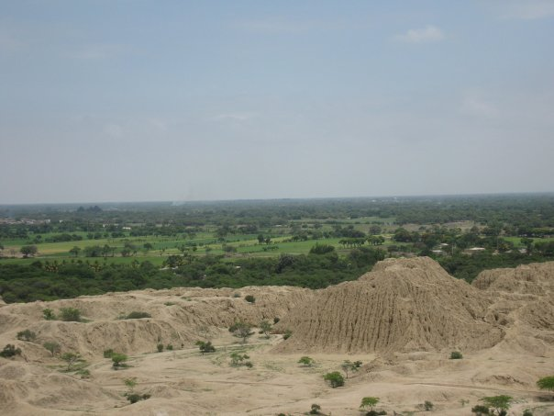
e
PERU
PPeru
By Mark & Kim DeJager

Slide 2
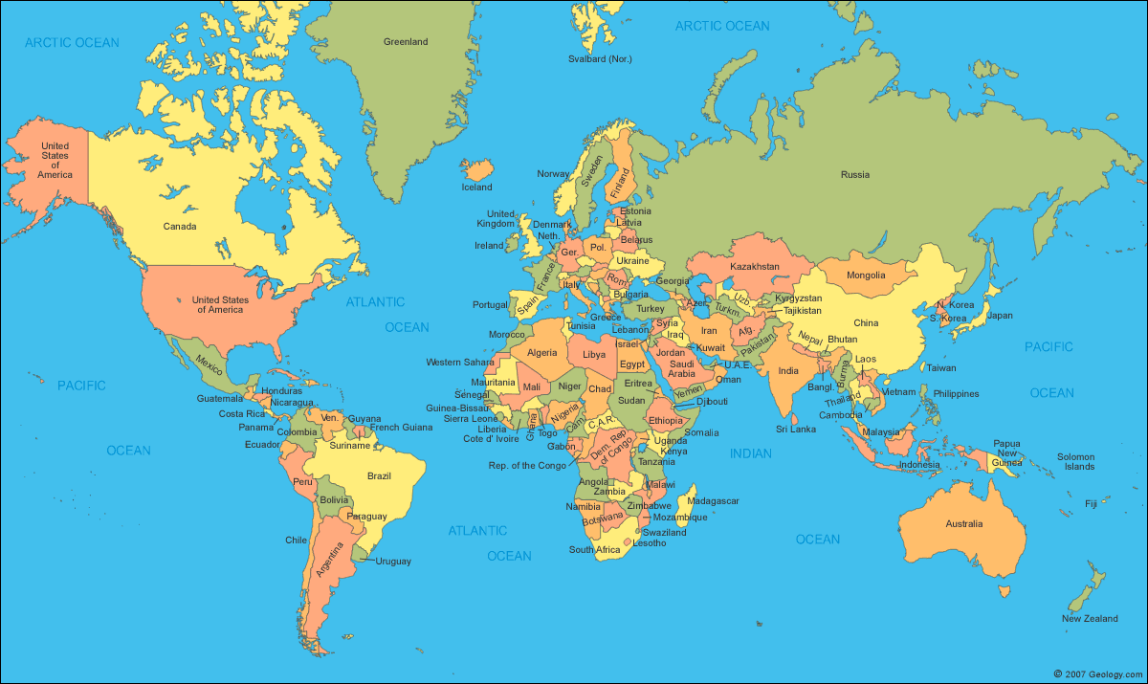

Slide 3
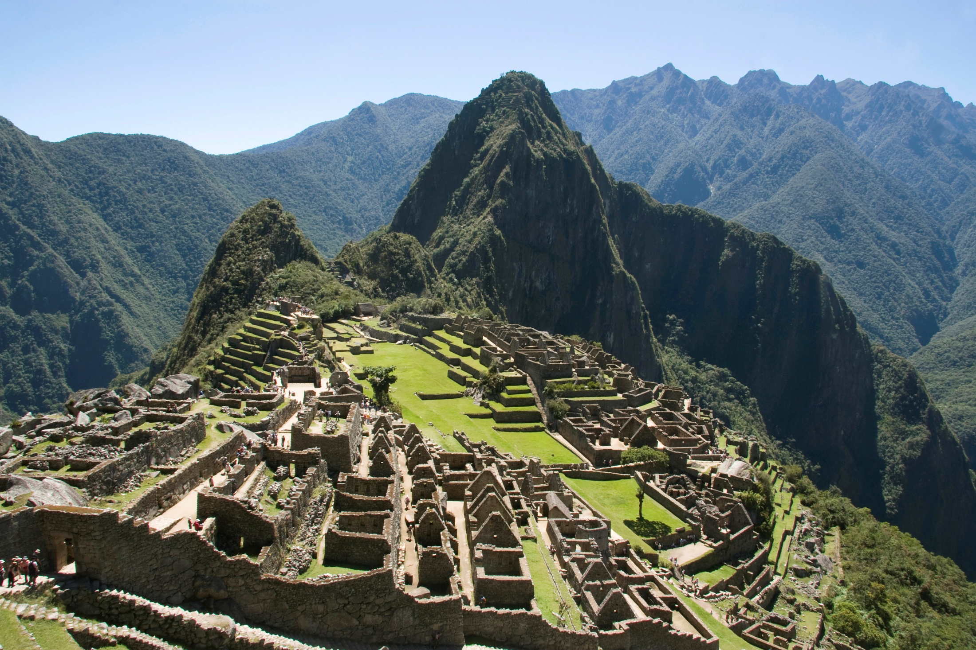

Slide 4
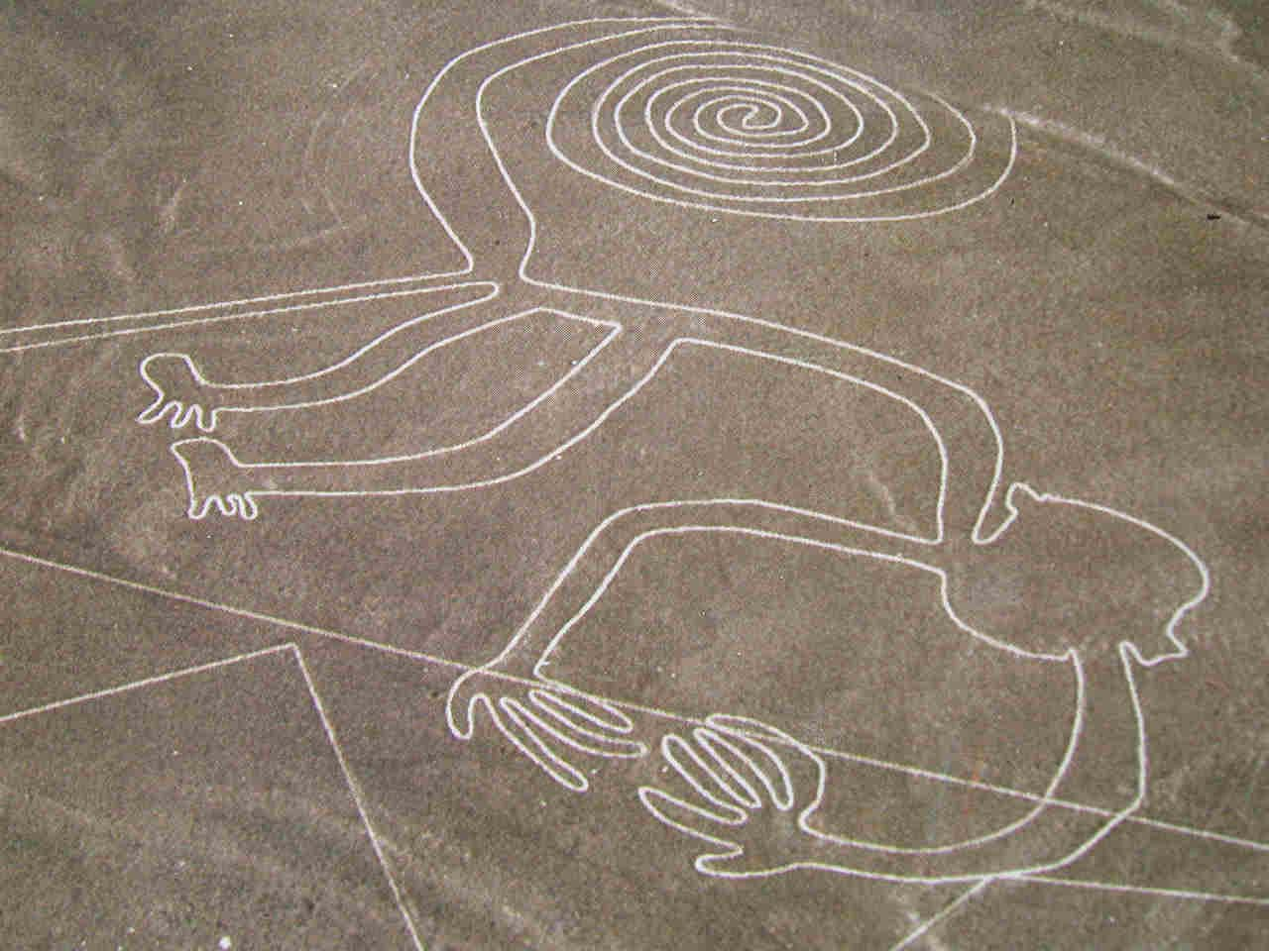

Slide 5
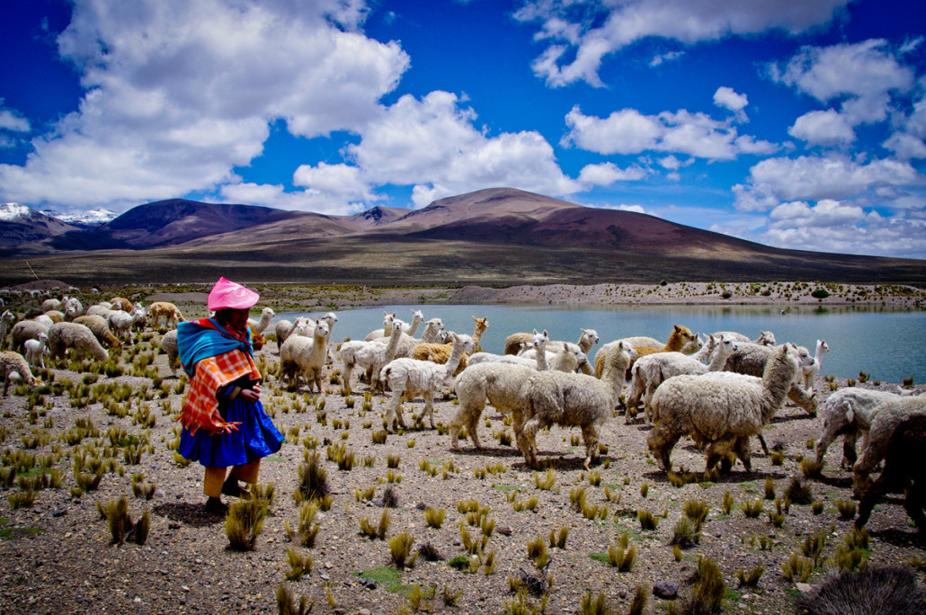

Slide 6
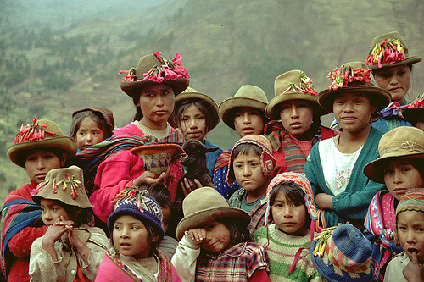

Slide 7
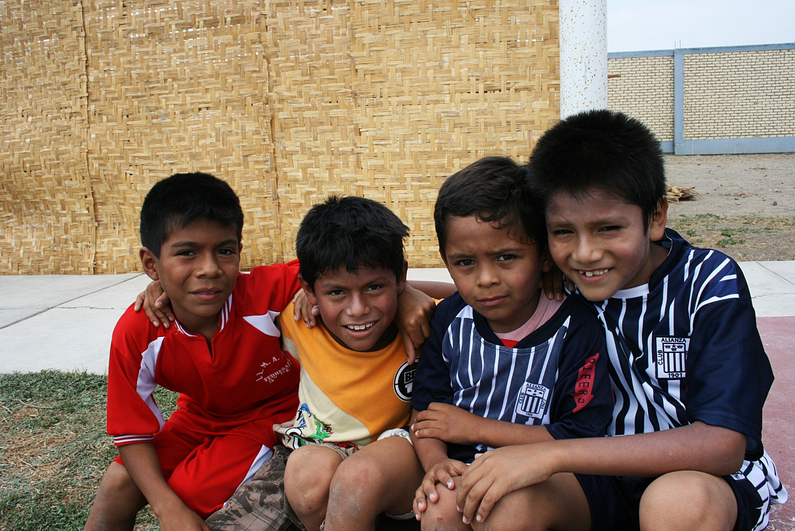
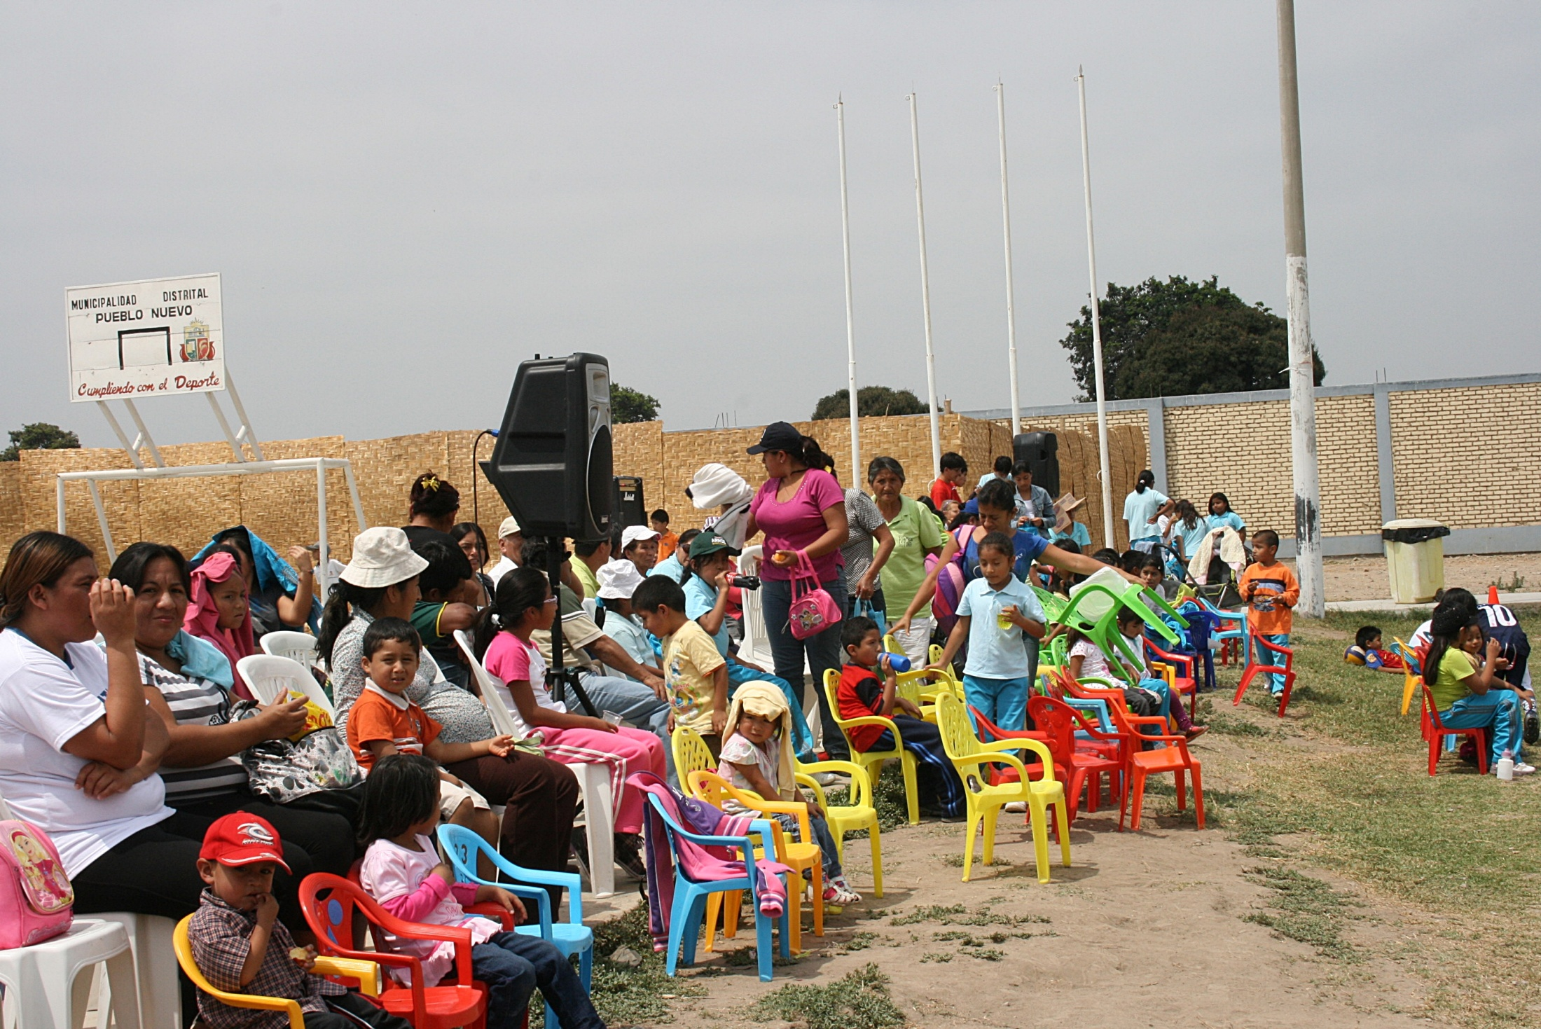
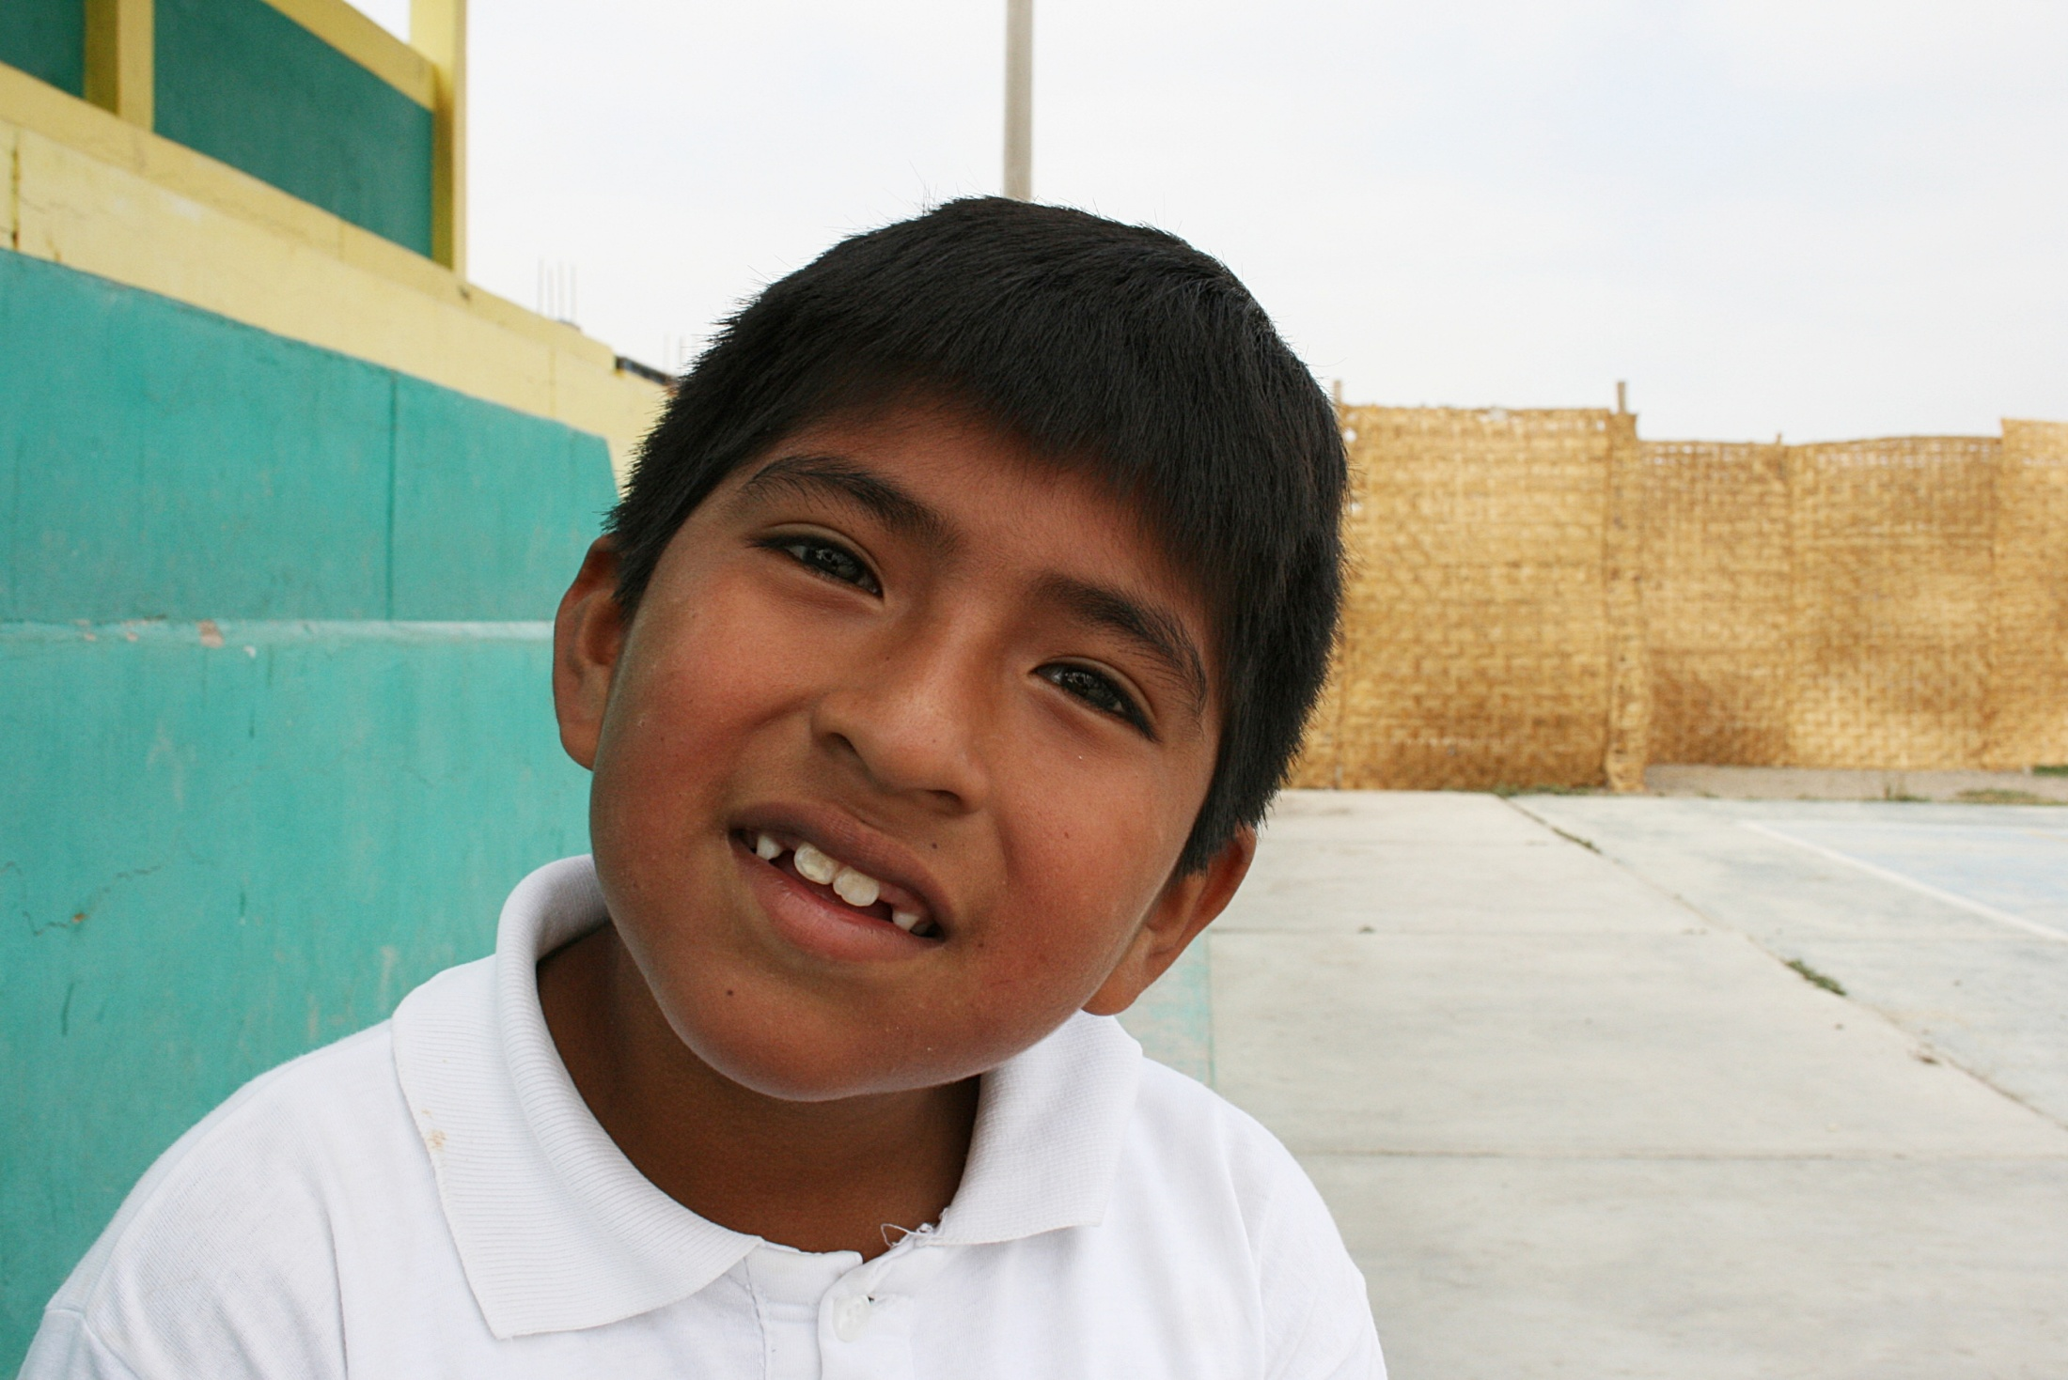

Slide 9
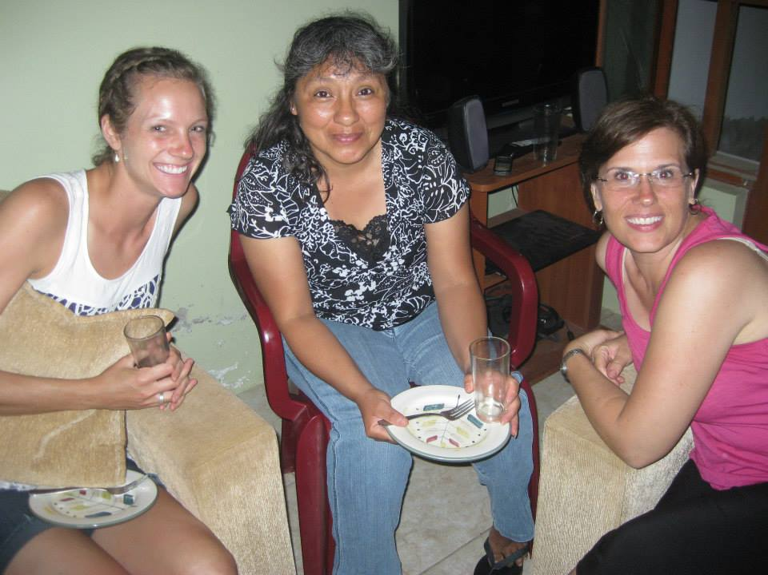

Slide 10
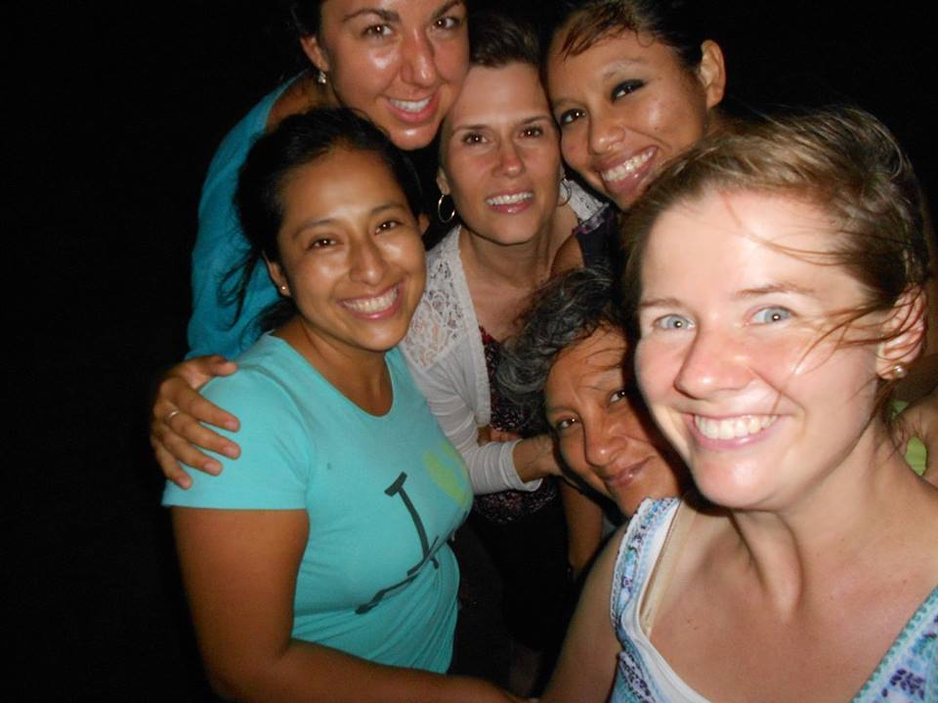

Slide 11
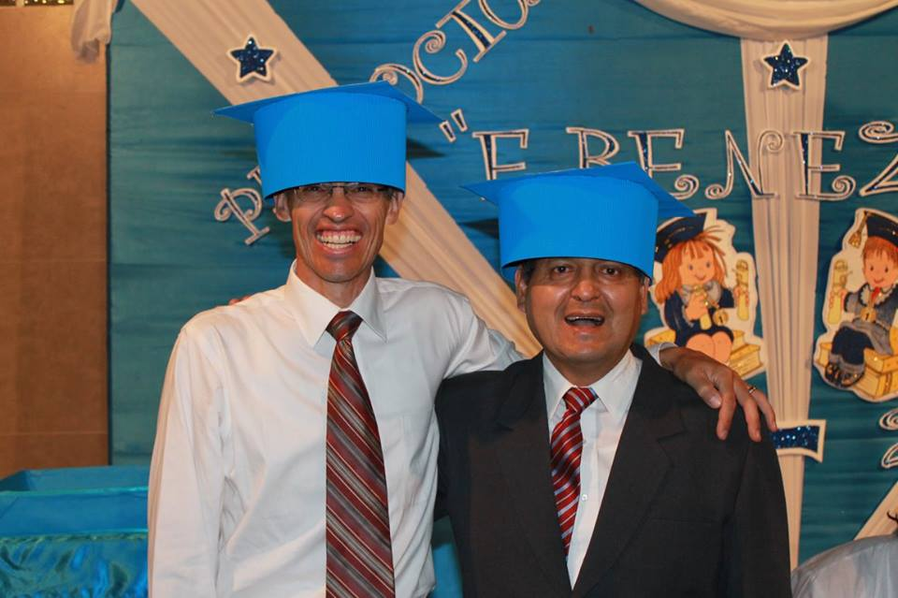

Slide 12
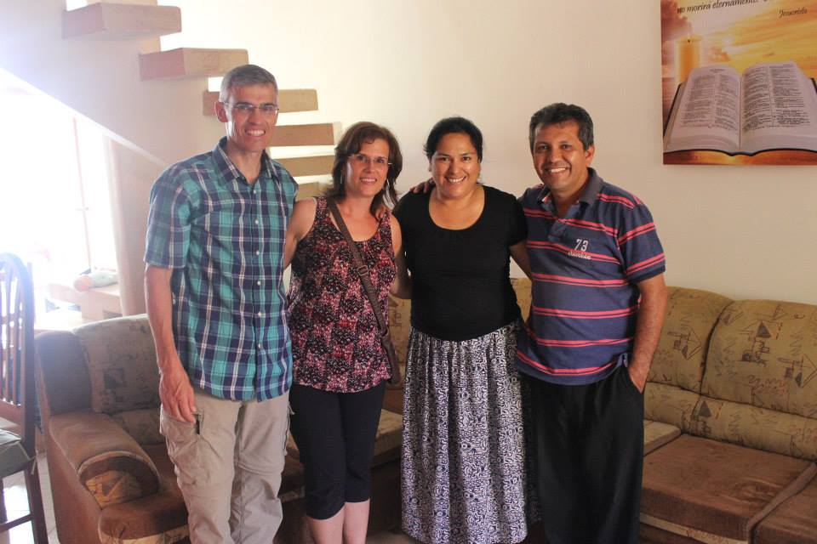

Slide 13
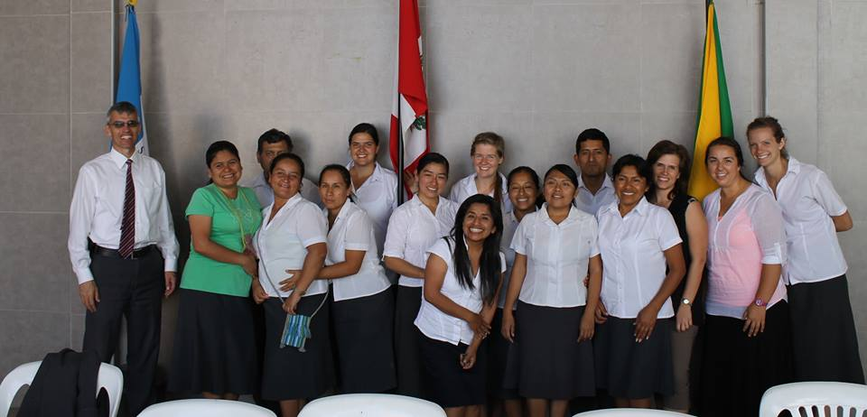

Slide 14
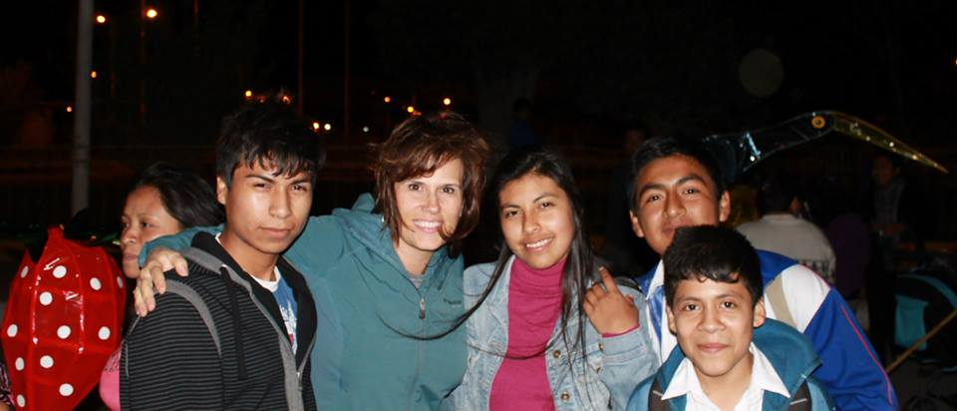

Slide 15
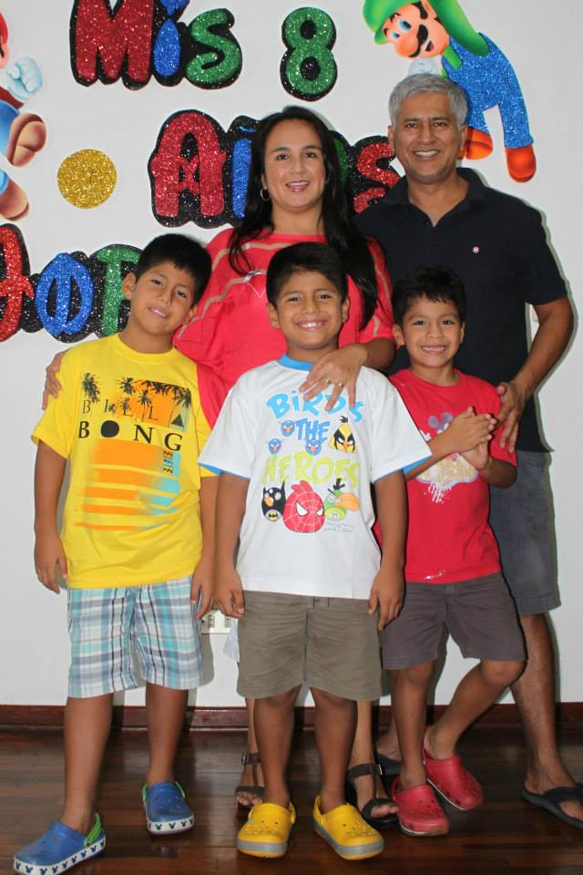
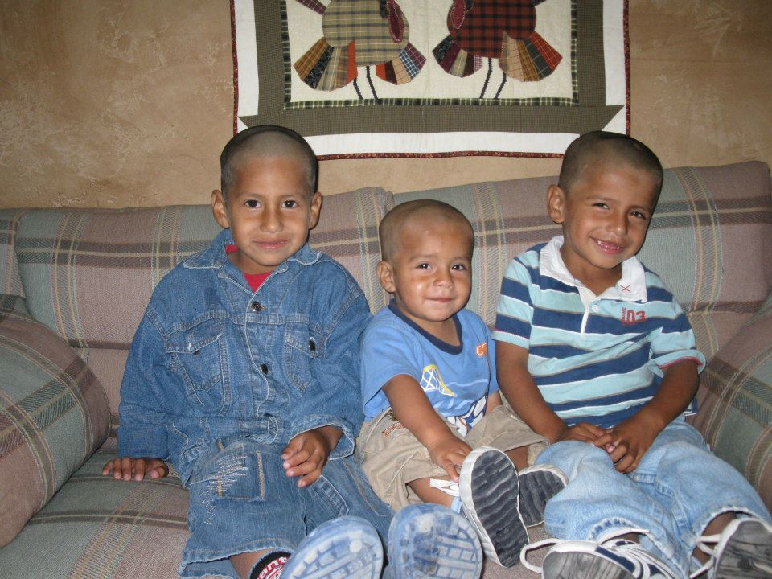

Slide 16
What is the command?
Go therefore and make disciples of all nation Matthew 28:19

Slide 17
Where are we to do this?
you will be my witnesses in Jerusalem and in all Judea and Samaria, and to the end of the earth Acts 1:8
Or
Dartmouth, the Maritimes and Peru

Slide 18
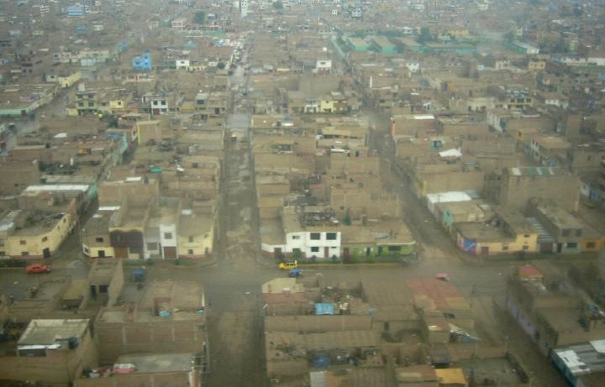

Slide 19
What are some different things for us?
Simple things
Documents
Language
Food
Money
Weather
Bugs and other creepy things
Customs
Homesickness

Slide 20
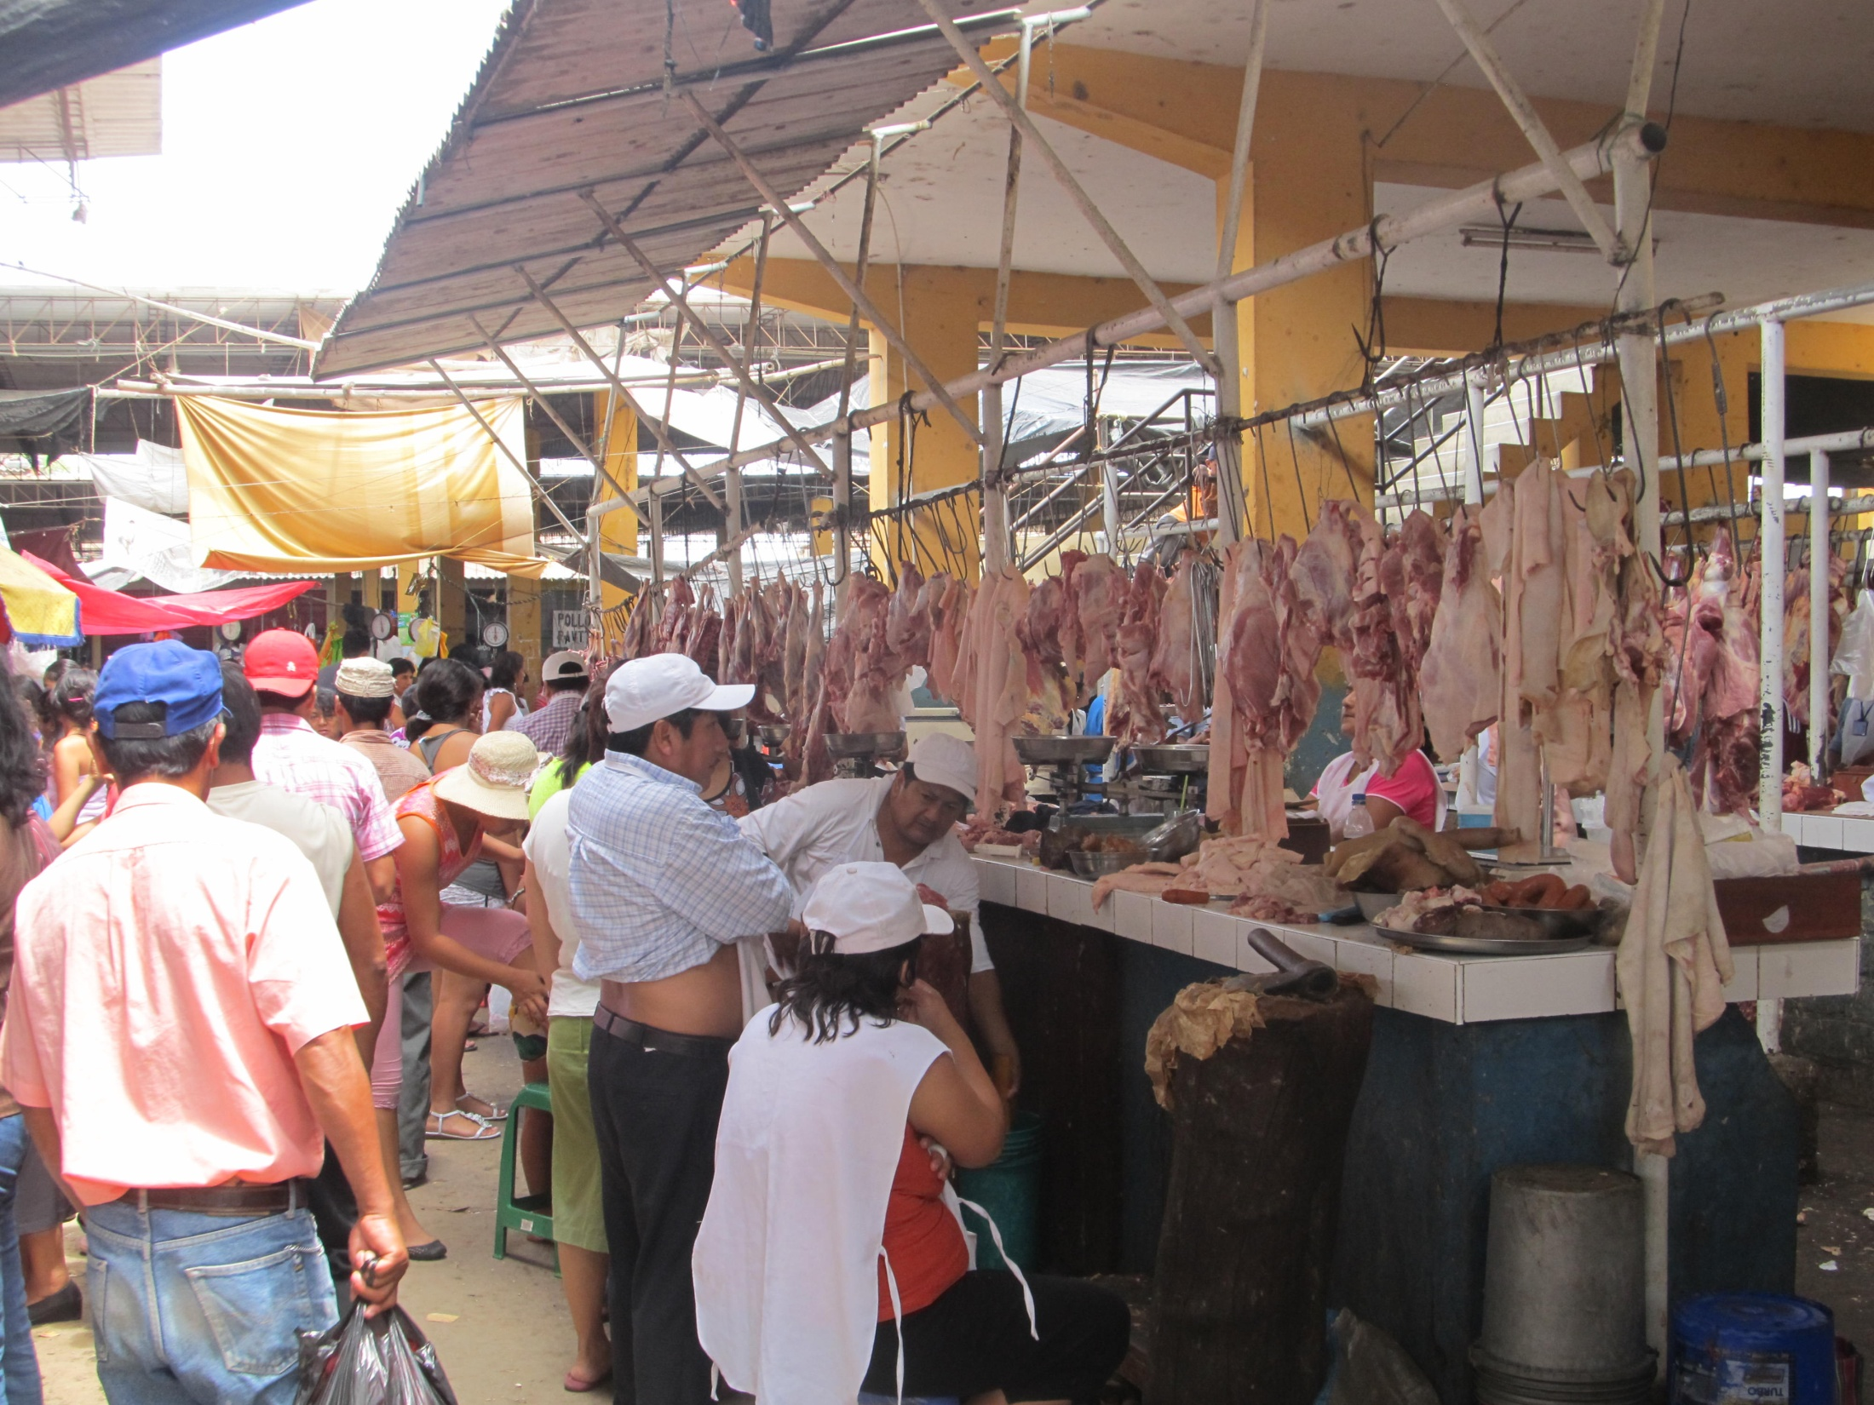

Slide 21
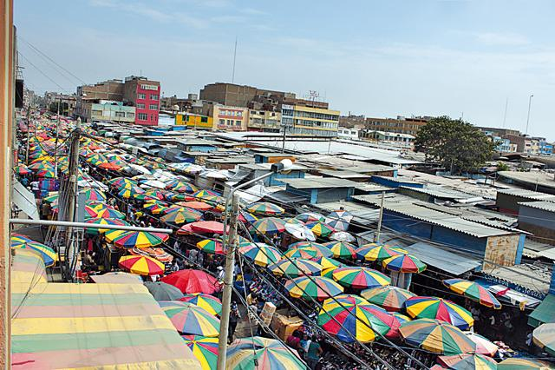

Slide 22
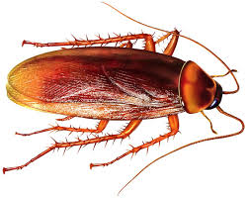

Slide 23
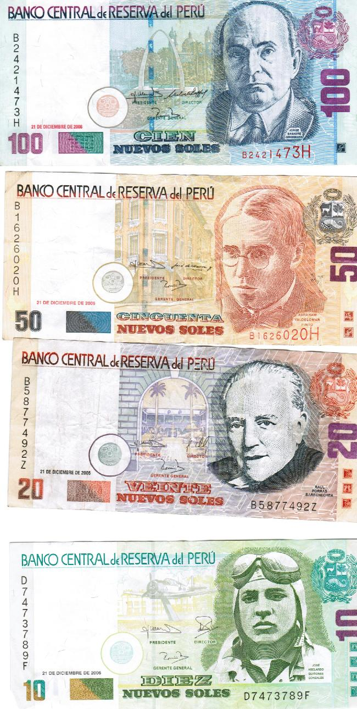
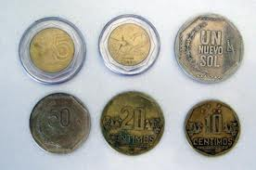
1 Canadian $ =
2.6 Nuevo Soles
Peru is a leader in counterfeit money

Slide 24
1)The potato is originally from Peru, and there are over 3,000 different varieties.
2) Peru grows more than 55 varieties of corn, with nearly any color including yellow, purple, white and black.
3)Peru is the 6th largest producer of gold.
4)Two-thirds of Peru is covered in prime Amazon Rain Forest.
6)In Peru, it is tradition to give friends and family yellow underclothes on New Year’s Eve.
7)Peru’s is the 8th largest producer of coffee in the world, and is the single largest producer of cocaine in the world.
8) Lake Titicaca in Southern Peru is the world’s highest navigable lake, and South America’s largest lake.
9)Peru is home to the highest sand dune in the world at 3,860 ft.
10)In Chincha on Peru’s southern coast it is quite acceptable to eat cat!
11) Peru is the number one producer of Cocaine in the world

Slide 25
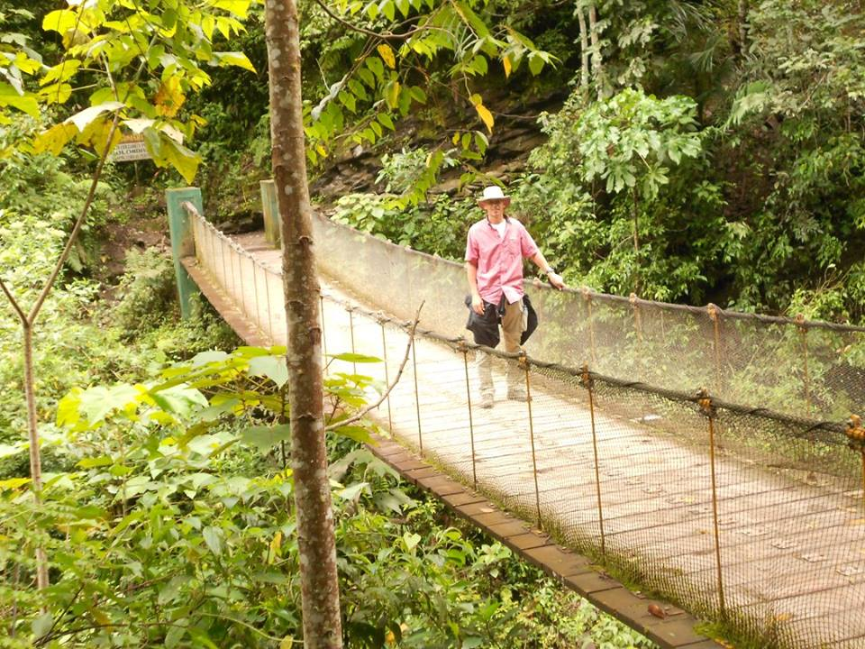

Slide 26
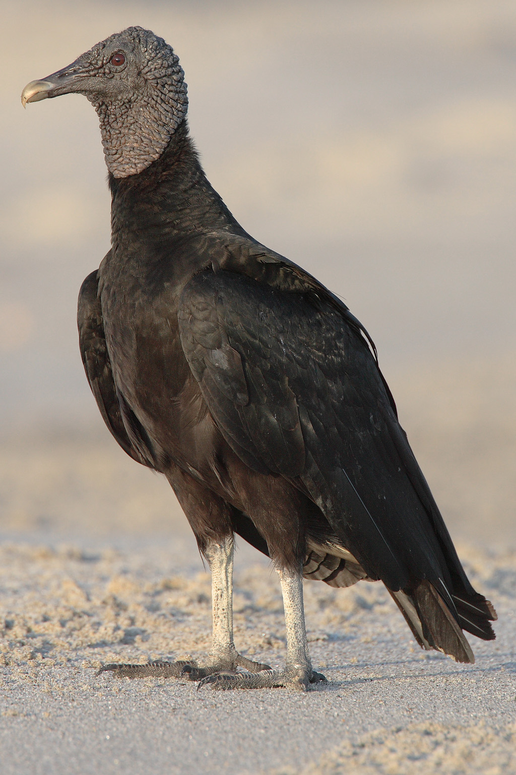

Slide 27
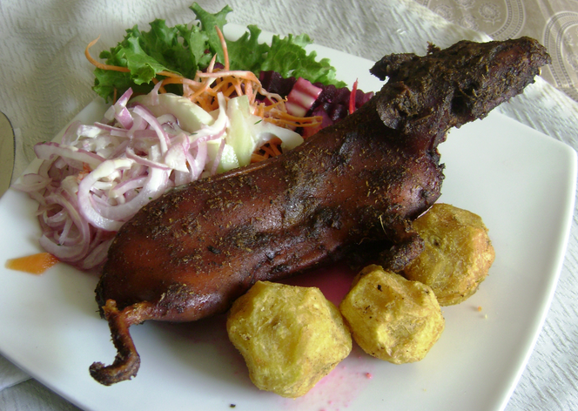

Slide 28
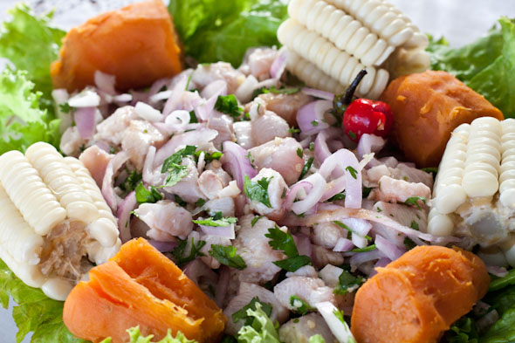

Slide 29
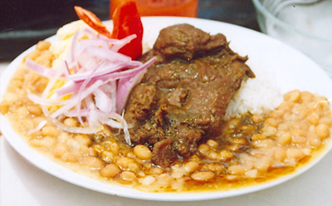

Slide 30
What are some challenges?
Culture shock
  Greetings
  Driving is different
  Different sense of order order
  Not time oriented
  Independence vs interdependence for their children
Culture adaptation
Culture frustration/stress
Very friendly
  Very curious
  Personal space is not an issue

Slide 31
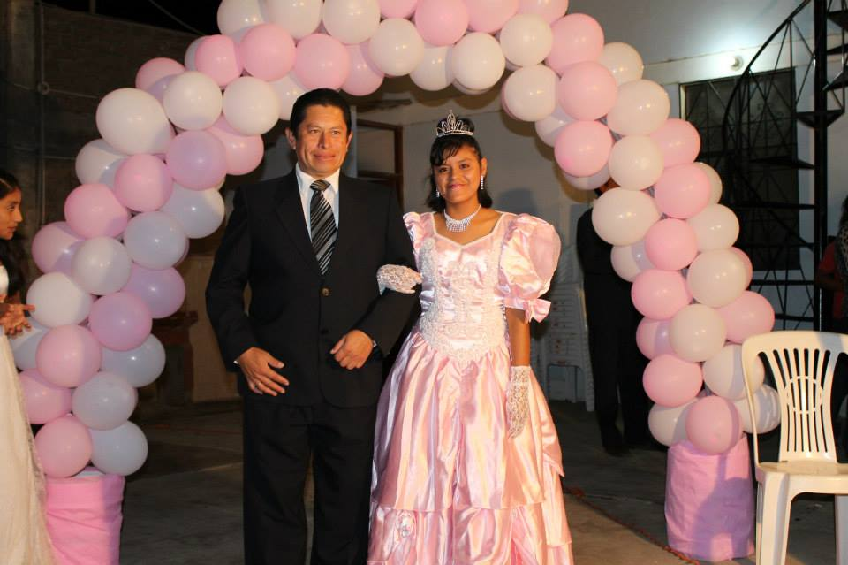

Slide 32
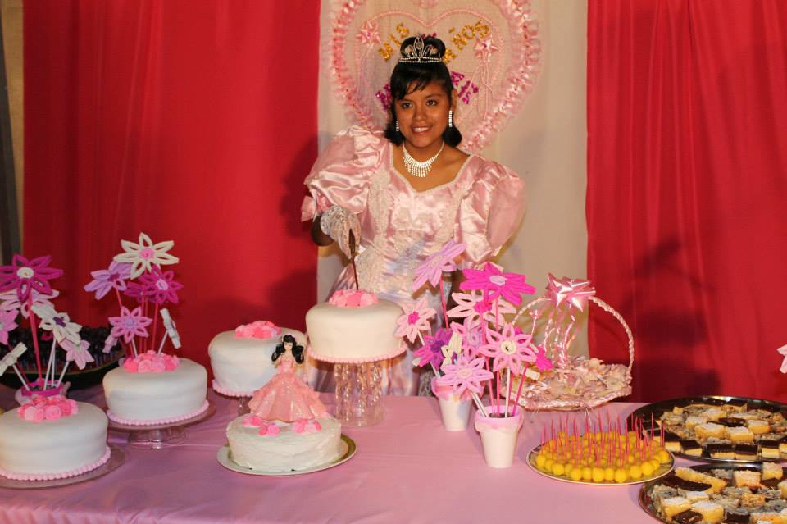

Slide 33
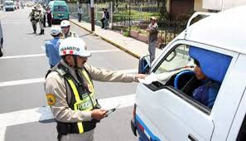

Slide 34
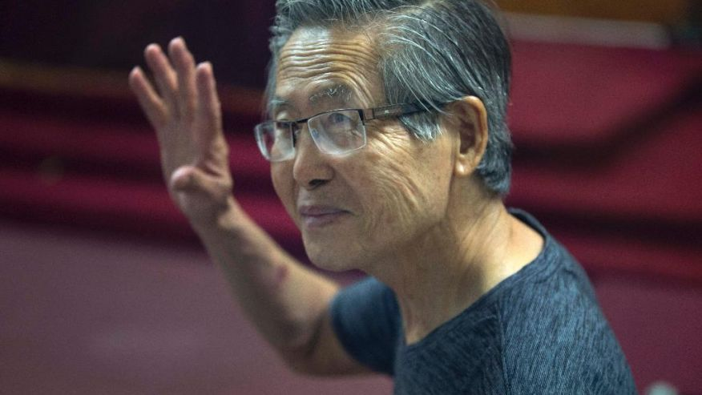

Slide 35
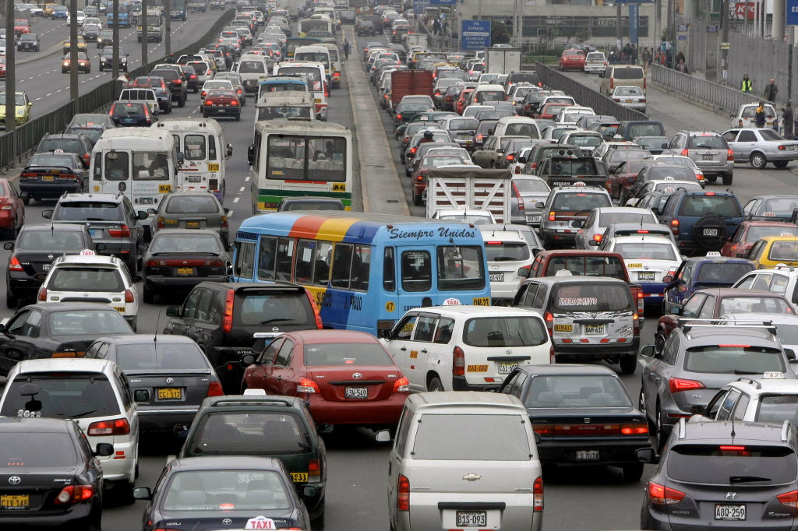

Slide 36
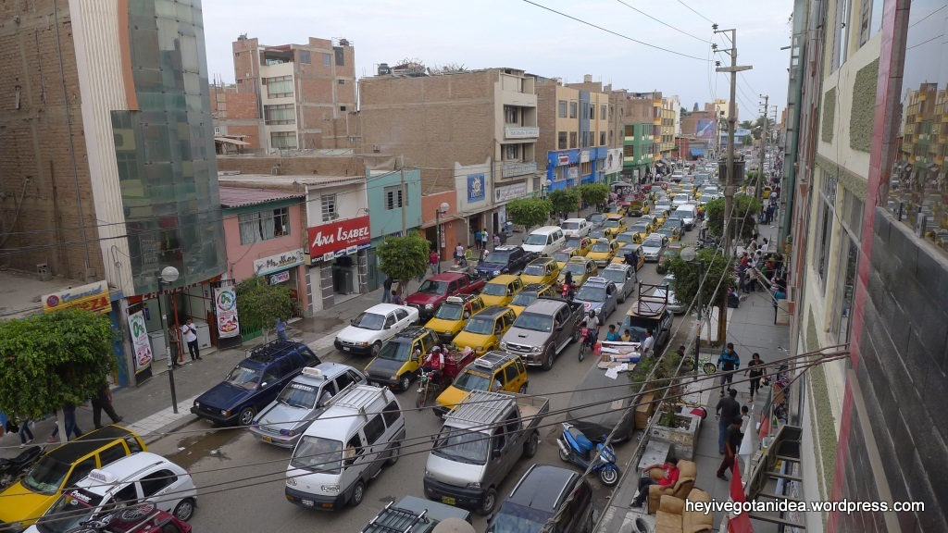

Slide 37
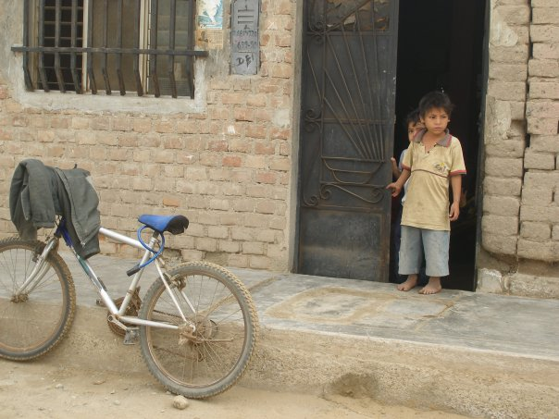

Slide 38
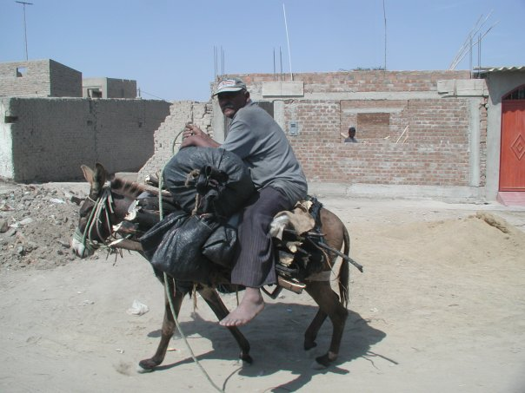

Slide 39
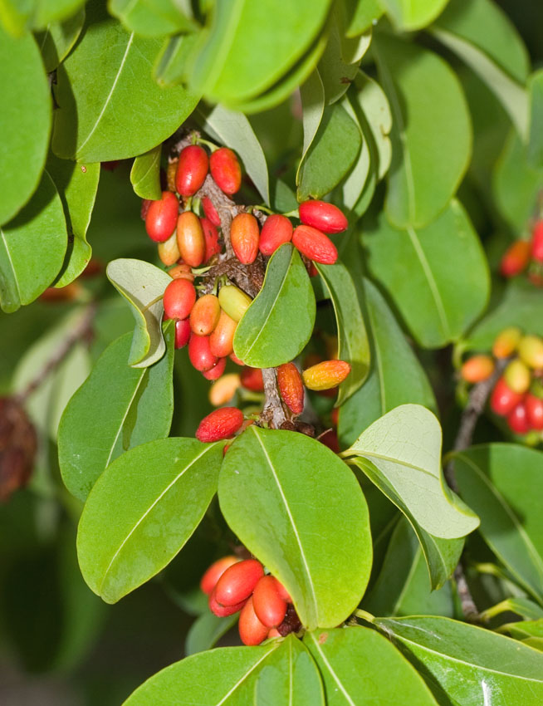

Slide 40
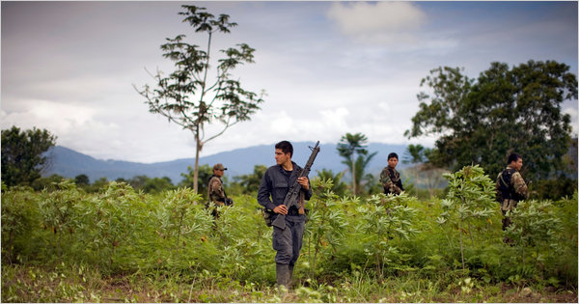

Slide 41
What have we been doing
School
Local Church
  Bible Studies
  Individual and group
  Weddings
  Funerals

Slide 42
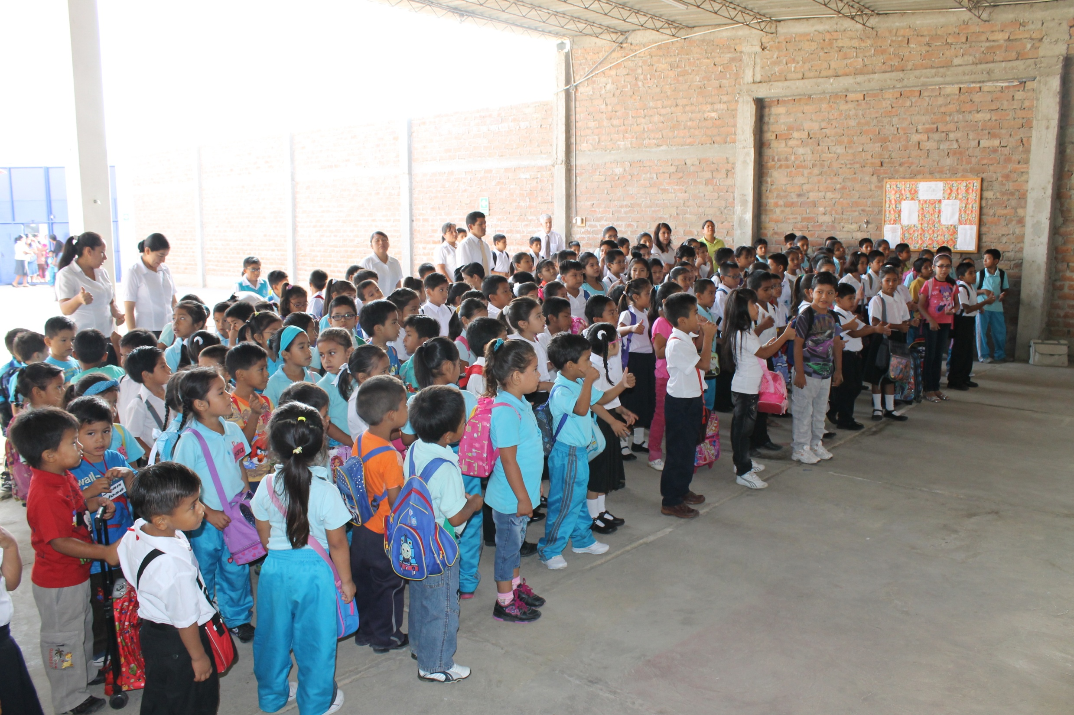

Slide 43
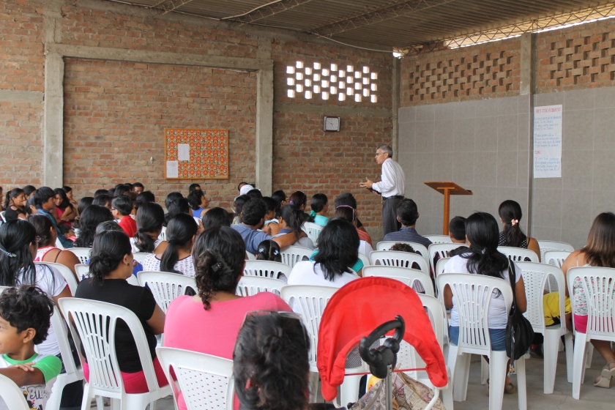

Slide 44
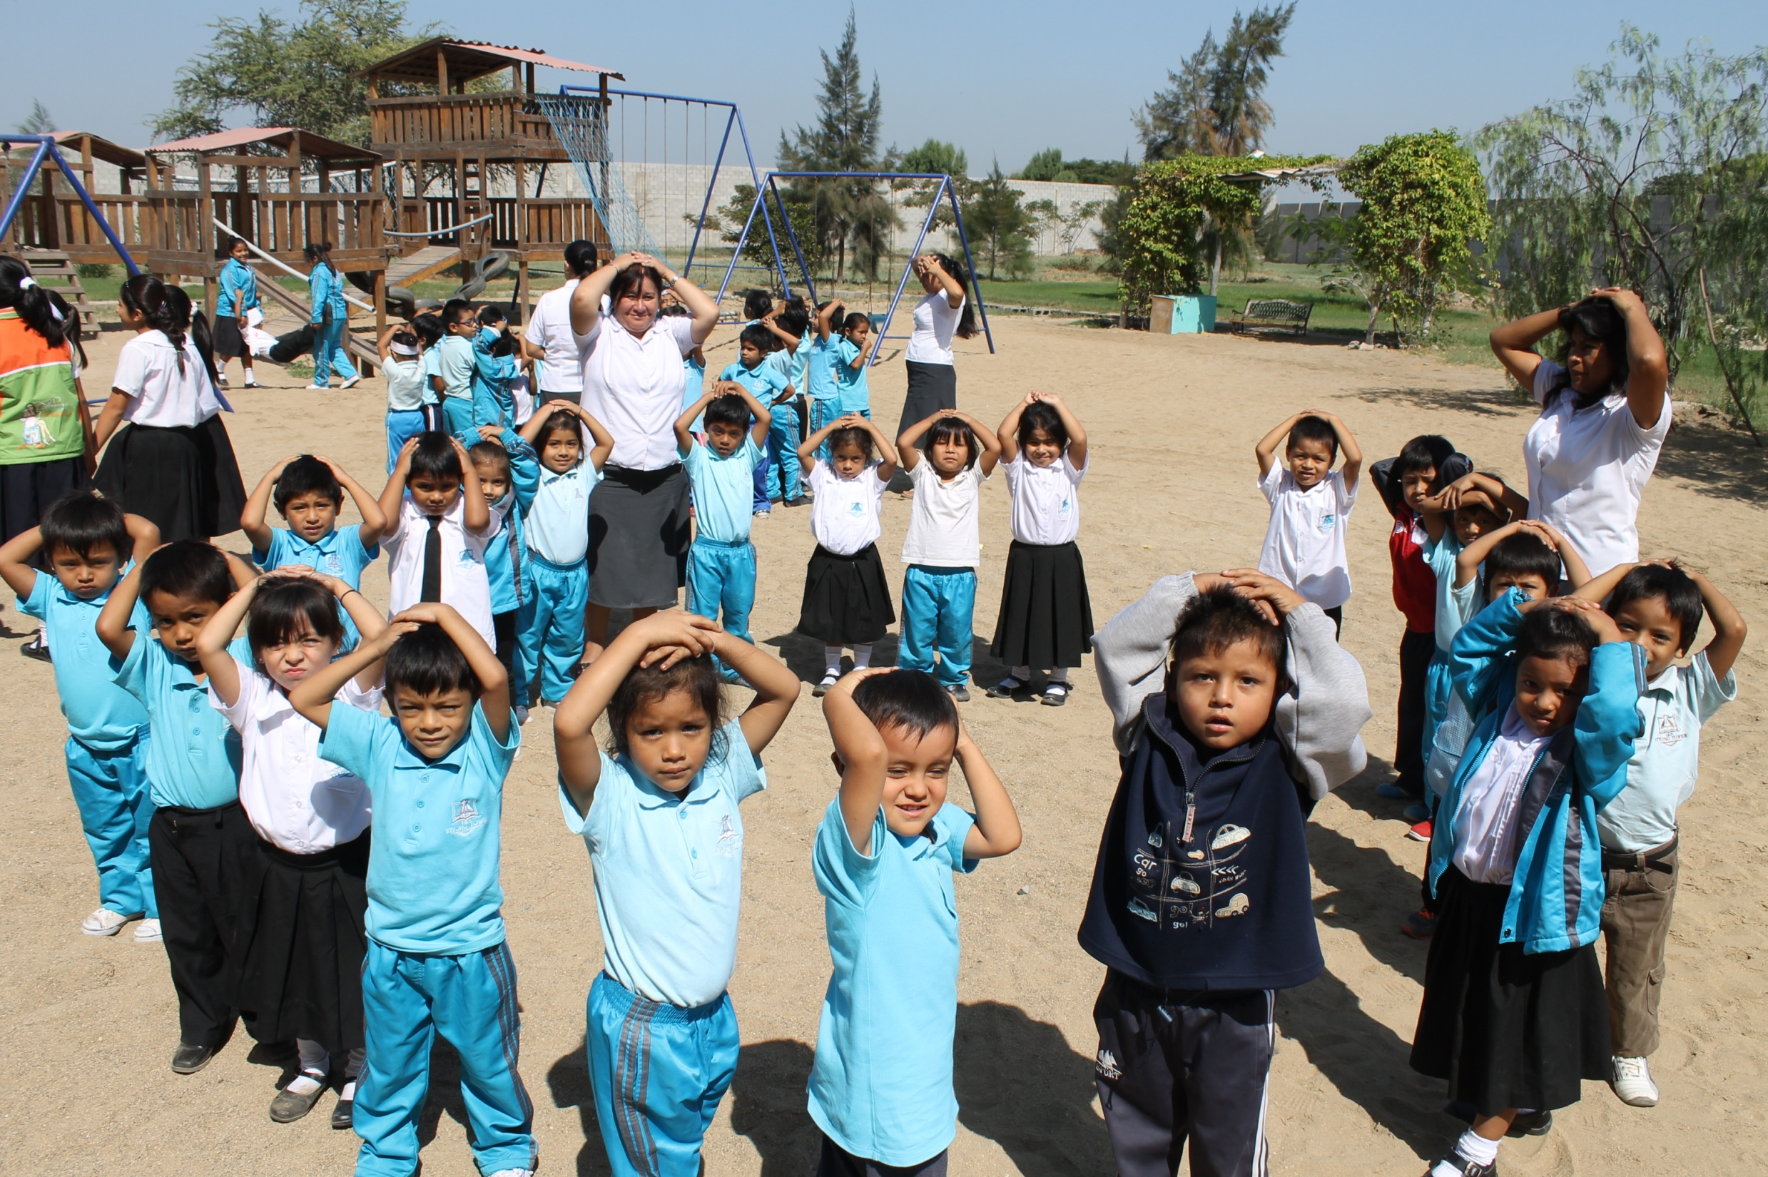

Slide 45
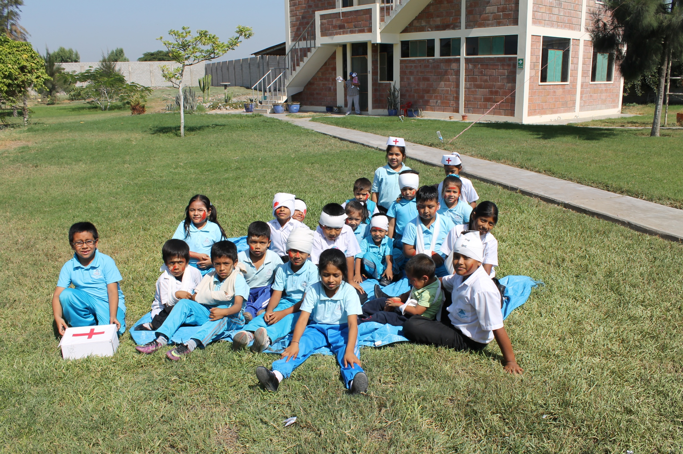

Slide 46
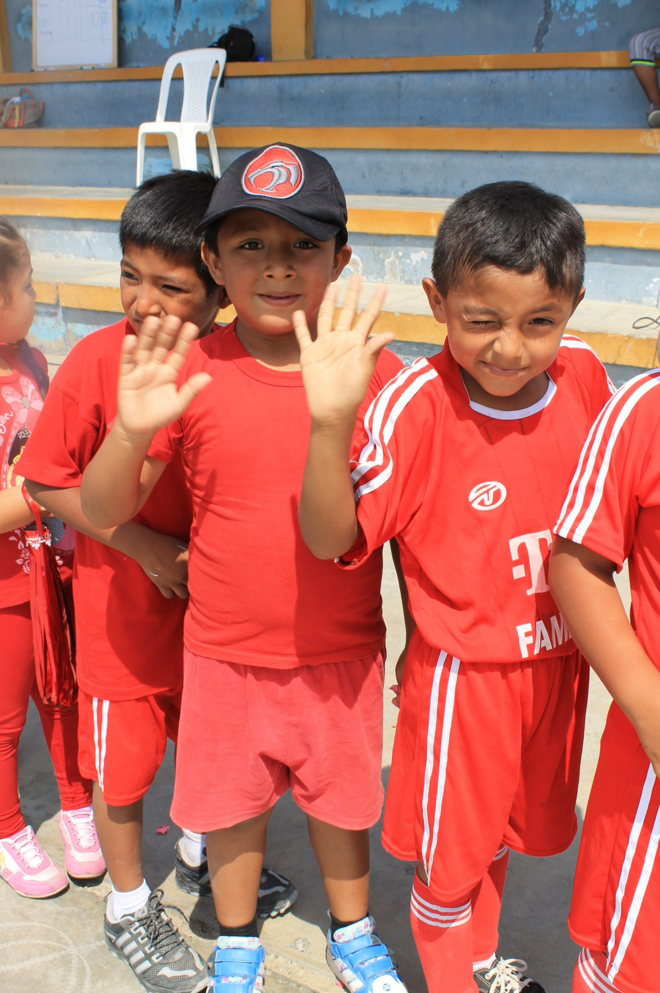

Slide 47
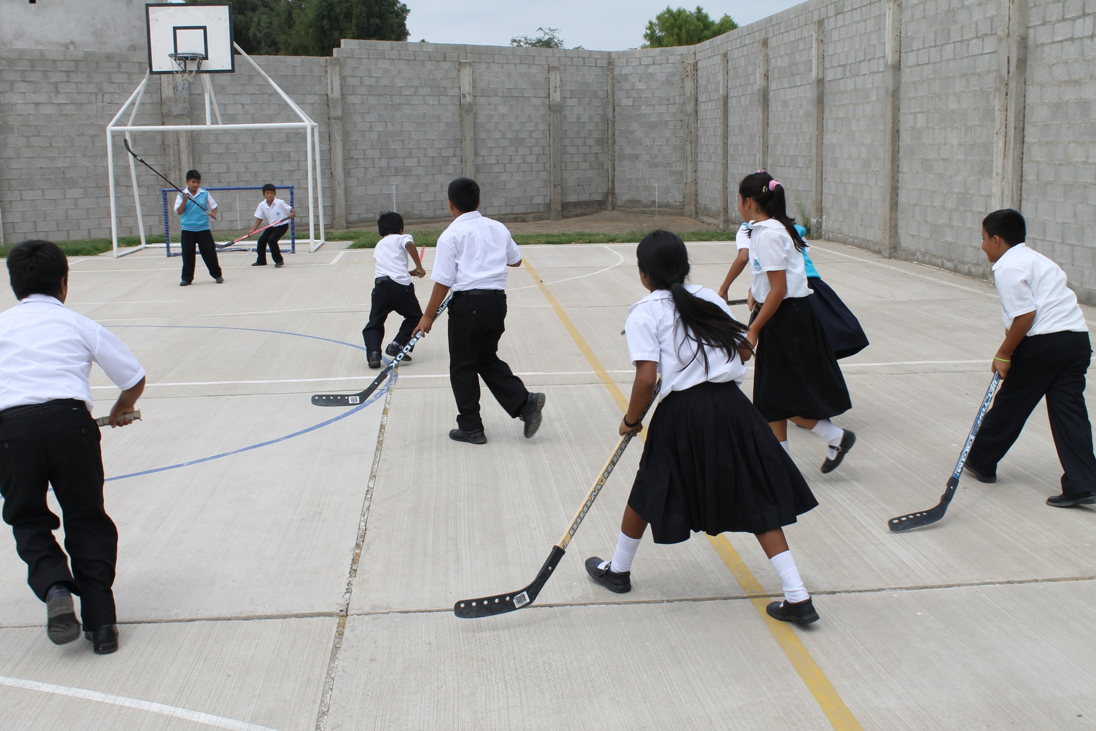

Slide 48
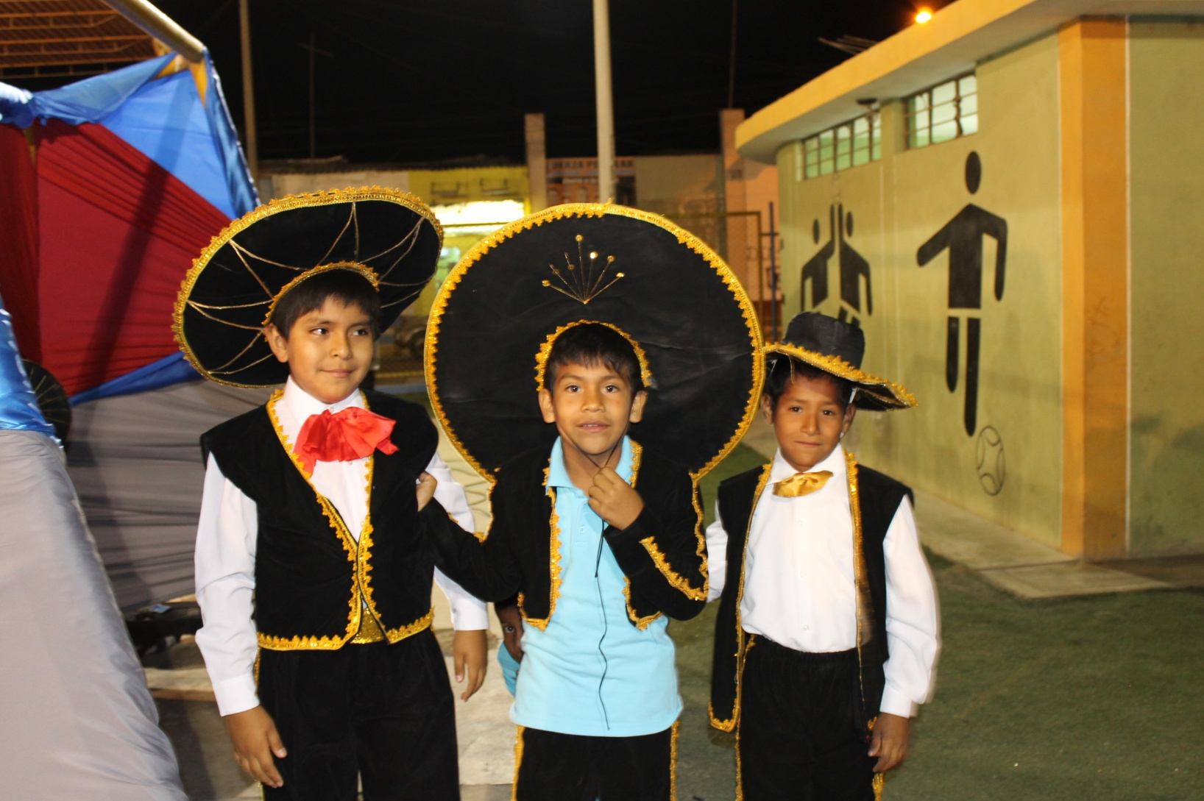

Slide 49
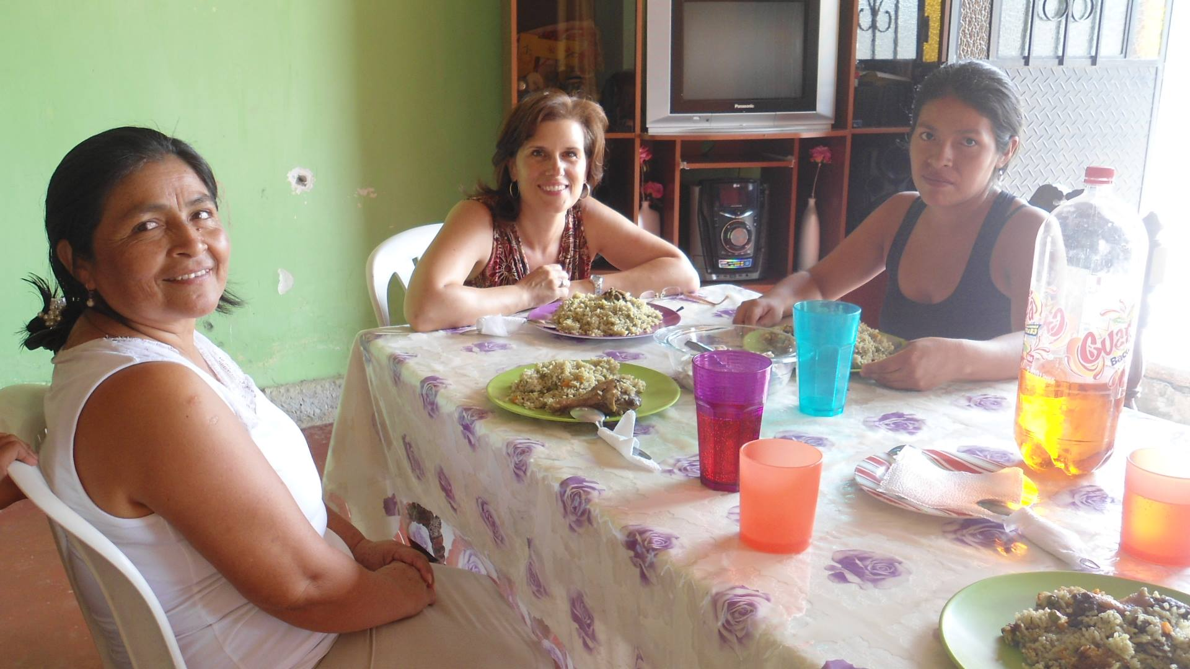

Slide 50
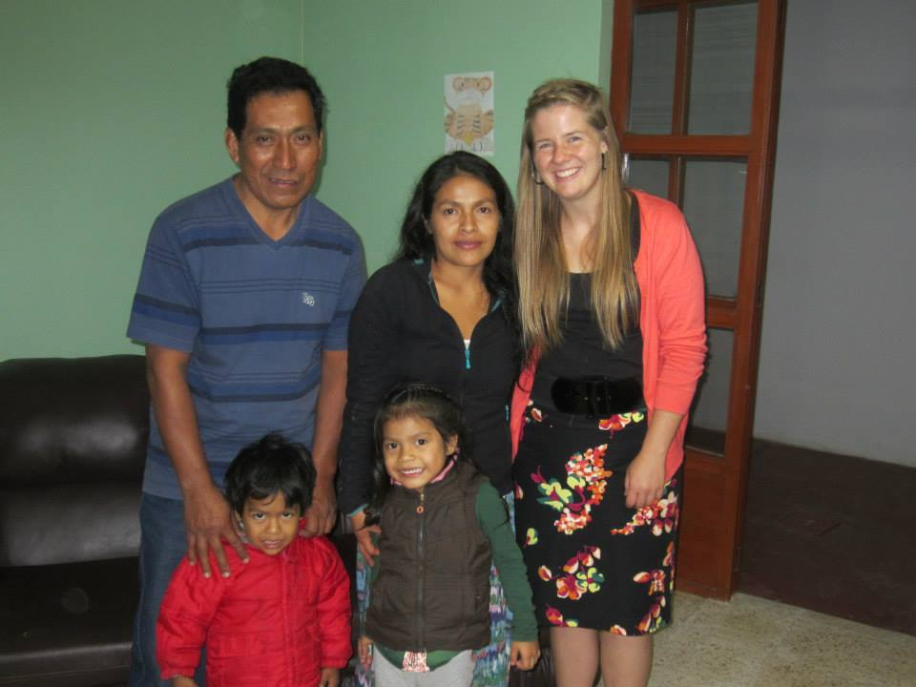

Slide 51



Slide 52


Slide 53


Slide 54


Slide 55


Slide 56


Slide 57


Slide 58


Slide 59



Slide 60



Slide 61


Slide 62


Slide 63


Slide 64
What now?
We finished at the school
  More time for other things
Home for Grad and a Wedding
Praying for direction
Visa expires in October
Jonny starts 12th grade in September
Several opportunities

Slide 65
What can you pray for
God’s leading
The believers in Peru
Workers

