Slide 1
Autonomy of the
Local Church

Slide 2
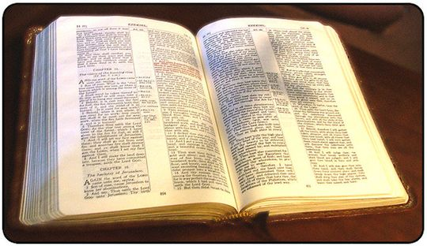
Autonomy is a Greek word and means: Auto (self) and nomos (law); meaning, self-law or self-governing.*
Notes:
Without outside control
Though the word autonomy is not found in the Bible, we know that it clearly describes the function of local churches

Slide 3
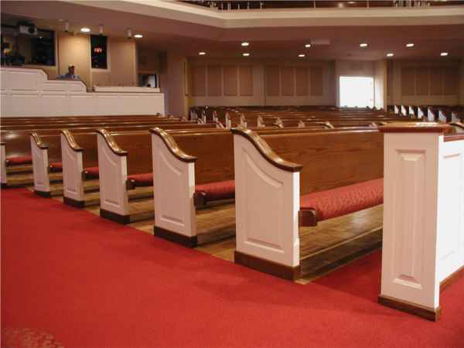
Three Aspects of the Local Church
Self governing
Self supporting
Self propagating

Slide 4
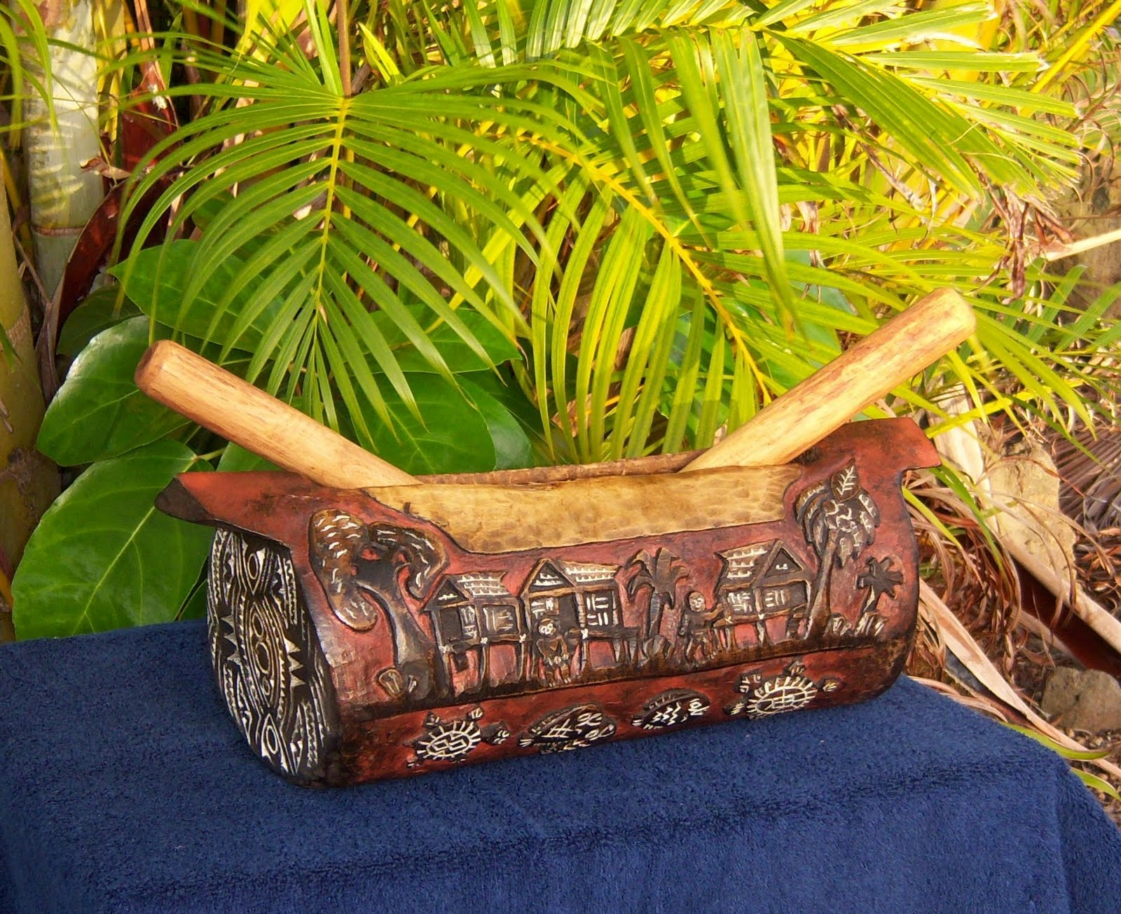
Definition for “Church” in Greek
Ekklesia
Ek – out of
Klesia – to call
Notes:
Same in Kafe...mono...assembly, gathering
The word "ekklesia" is found in one hundred and fifteen places in the New Testament. It is translated in English one hundred and thirteen times "church" and the remaining times it is translated "assembly." In classical Greek the word "ekklesia" meant "an assembly of citizens summoned by the crier, the legislative assembly. The word as used in the New Testament is taken from the root of this word, which simply means to "call out." In New Testament times the word was exclusively used to represent a group of people assembled together for a particular cause or purpose. It was never used exclusively to refer to a religious meeting or group.

Slide 5
Two aspects to the Church
The Universal Church
The Local Church

Slide 6
The Universal Church
Mat 16:18 ...and upon this rock I will build my church.
Eph 5:23 For the husband is the head of the wife, even as Christ is the head of the church: and he is the saviour of the body.
Notes:
He was including all believers in all the world in His church. Thus, He was speaking of the universal church.
The univ church has no earthly leadership/rolls or gifts. Christ is the only head and leader

Slide 7
ALL SAVED
Represents Many People From Local Churches
Colosse
Universal Church
Galatia
Phillipi
Corinth
Jerusalem
Ephesus
Antioch
Notes:
Can be unsaved in a local church. Also many believers from different Denominations in the Universal church

Slide 8
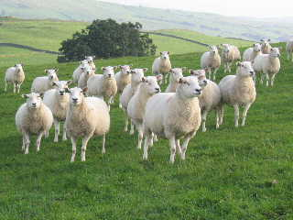
The Local Church
Act 20:28 Take heed therefore unto yourselves, and to all the flock, over the which the Holy Ghost hath made you overseers, to feed the church of God, which he hath purchased with his own blood.
1Ti 3:5 (For if a man know not how to rule his own house, how shall he take care of the church of God?)
Notes:
This constitutes a direct statement to the effect that local autonomous government is the pattern for each local assembly.
Not flocks, plural

Slide 9
The Local Church
1Co 1:2 Unto the church of God which is at Corinth, to them that are sanctified in Christ Jesus, called to be saints...
1Th 1:1 Paul, and Silvanus, and Timotheus, unto the church of the Thessalonians which is in God the Father and in the Lord Jesus Christ
Rom 16:16 The churches of Christ greet you.
Notes:
First Corinthian letter to “the church of God which is at Corinth,” he was speaking to a group of Christians in Corinth who met together to worship and serve God
The universal church is made up of all the believers of these local congregations that were everywhere. Paul referred to this when he said: “All the churches of Christ salute you” Rom 16:16

Slide 10
The Local Church
The local church has geographic location, either unassembled or assembled.
Act 14:27 And when they were come, and had gathered the church together, they rehearsed all that God had done with them, and how he had opened the door of faith unto the Gentiles.
Believers that fellowship here represent this assembly.

Slide 11
The Local Church
The local church when fully organized has elders and those in fellowship are to submit themselves to the rule of the elders.
Heb 13:17 Obey them that have the rule over you, and submit yourselves: for they watch for your souls, as they that must give account, that they may do it with joy, and not with grief: for that is unprofitable for you.
Not talking about submitting to elders elsewhere*

Slide 12
The Local Church
The local church is not a denomination, but is simply a group of Christians who have come together for the purpose of:
Eph 4:12 For the perfecting of the saints, for the work of the ministry, for the edifying of the body of Christ:
Act 2:42 And they continued steadfastly in the apostles' doctrine and fellowship, and in breaking of bread, and in prayers.
Act 2:47 Praising God, and having favour with all the people. And the Lord added to the church daily such as should be saved.
Notes:
List of reasons why we have come together

Slide 13
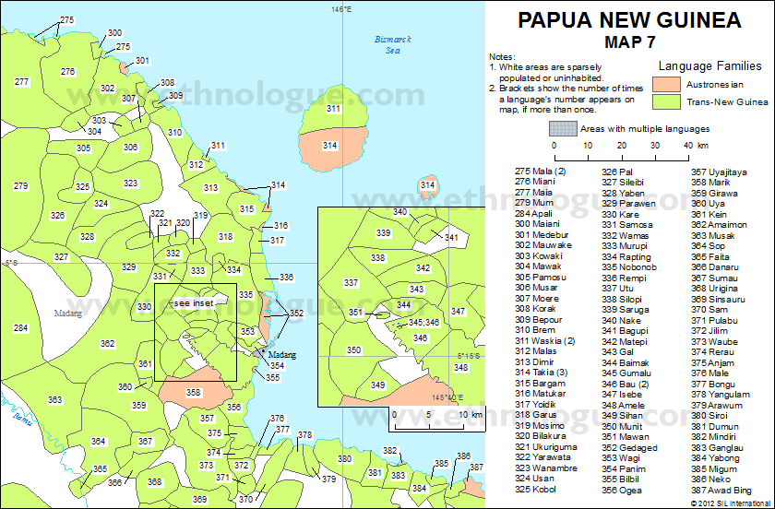
Notes:
Png many languages are really close to each other and it would be hard for a different lang over the mountain to have control over another church

Slide 14
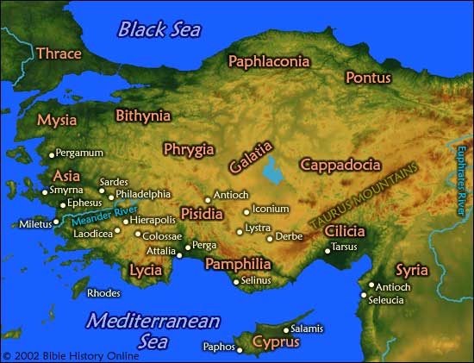
Notes:
Local assemblies with their own elders and no mention of a separate head.
If we have a denominational head church, and if it falls or gets a bad name and so does each local church.

Slide 15
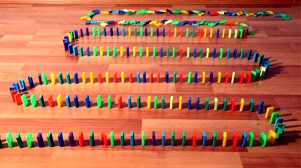
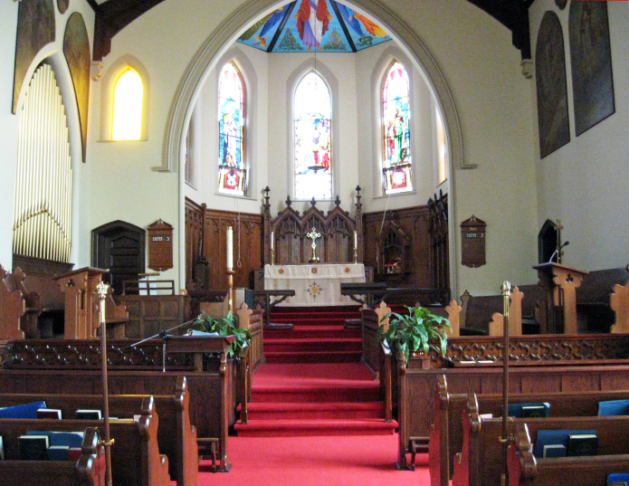
Notes:
The whole church goes down or splits...like Anglican...with homosexual topic
If we have a box of dominoes and divide them all up and one domino falls, it will take down all the other dominoes, but if we divide up all the dominoes into small groups, then if one falls it will not affect the other groups.

Slide 16





Slide 17
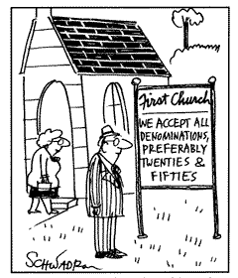

Slide 18

The Word of God
The Bible is the sole authority for faith and practice. The Bible alone determines what we must believe and do.
2 Timothy 3:16 All scripture is given by inspiration of God, and is profitable for doctrine, for reproof, for correction, for instruction in righteousness: **
Notes:
B. Jesus has all authority (Matt. 28: 18). Jesus has given us our Bible or his teaching (Jn. 12: 48). This one and only Book is authoritative and must be solely used to determine truth and practice (Gal. 2: 14, Jude 3).
Use Ill of Robert Vaughn talking to United Church minister....thought John in Rev was on drugs or you have the Catholic church which doesn’t take all the Word for what it is....Pope still gets info from God... Ill of churches in Africa that meet together who do not have the Bible in their language....

Slide 19
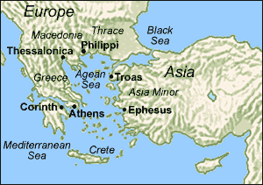
Sending Funds
Php 4:15 Now ye Philippians know also, that in the beginning of the gospel, when I departed from Macedonia, no church communicated with me as concerning giving and receiving, but ye only. 16 For even in Thessalonica ye sent once and again unto my necessity. +
Notes:
the local church at Philippi did not send to the church at Thessalonica, but to Paul himself. This was not an isolated practice. While preaching for the Corinthian church, Paul took wages from other local churches. Again, these funds were manifestly sent to Paul, not to the church at Corinth (2 Cor. 11: 8).
The church Philippi was free to act autonomously and send finances to Paul. They did not feel that they need to send the money first to thessalonica for them to distribute the money to him.
a. To have a receiving and distributing church is clearly in violation of autonomy. One set of local elders cannot scripturally oversee another local church(es), such a practice contradicts principles of autonomy (I Pet. 5: 2).

Slide 20
In reference to elders
1Pe 5:2 Feed the flock of God which is among you, taking the oversight thereof, not by constraint, but willingly; not for filthy lucre, but of a ready mind;
Act 14:23 And when they had ordained them elders in every church, and had prayed with fasting, they commended them to the Lord, on whom they believed.
Act 20:28 Take heed therefore unto yourselves, and to all the flock, over the which the Holy Ghost hath made you overseers, to feed the church of God, which he hath purchased with his own blood.+
Notes:
These verses limit the authority of elders to the flock where they fellowship. This constitutes a direct statement to the effect that local autonomous government is the exclusive pattern.
The assemblies were guided independently...not by a foreign head They even functioned independently
Notice the following passages, which reveal the elders oversight is limited to the local congregation of which they are a part
The reality of autonomy in local churches is readily seen in the fact that elders were to be appointed in each local church (Acts 14: 23)
Moreover, these elders only had rule and authority in the local church where they served (I Pet. 5: 2).
To the converse, if God had not desired each local church to be a self-governing unit, he would have simply had a group of elders over all the churches

Slide 21
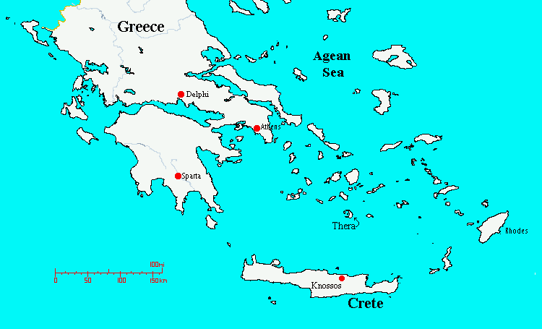
In reference to elders
Tit 1:5 For this cause left I thee in Crete, that thou shouldest set in order the things that are wanting, and ordain elders in every city, as I had appointed thee:
Elders plural in each assembly singular.*
Notes:
Not a group of elders over all the churches but elders plural in each assembly singular
They organized themselves independently and within their own culture...compare assemblies even overseas...poorer assemblies made do with what God gave them. In catholicism people became poor by the buildings they set up and of course buying their way into purgatory

Slide 22
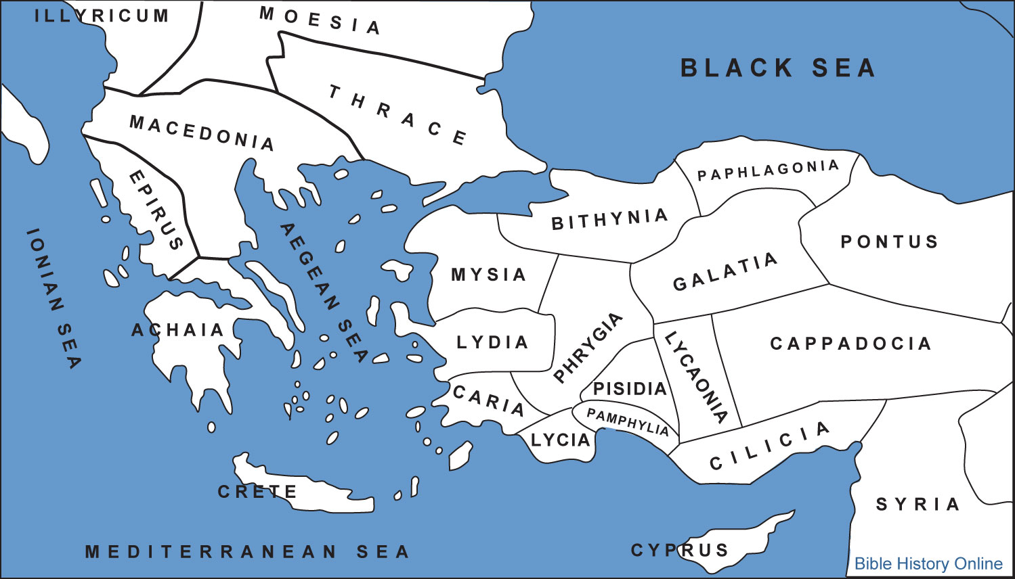
We are Autonomous Meetings
Gal 1:2 And all the brethren which are with me, unto the churches of Galatia:
Each assembly has its own elders to provide leadership for the meeting.+
Notes:
there was no district organization. Each of the churches in Galatia would have been self governed, looking to Christ the Head.
These assemblies, when ever they were born, became separate independent churches and were able to function as a New Testament assembly and were able to administer their own government without having a separate head to govern them.
Open assemblies are autonomous meetings

Slide 23
We have one Head...Jesus Christ
Eph 1:22 And hath put all things under his feet, and gave him to be the head over all things to the church, 23 Which is his body, the fulness of him that filleth all in all. +
Notes:
We have no separate head our only head is Jesus Christ. Jesus Christ, by his Holy Spirit and through is holy word is able to speak to the elders in such a way that the elders do not need to look to a separate earthly head to carry on their duties within the local assembly.

Slide 24
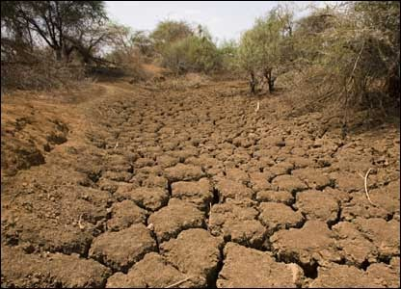
Act 11:27 And in these days came prophets from Jerusalem unto Antioch.
Act 11:28 And there stood up one of them named Agabus, and signified by the Spirit that there should be great dearth throughout all the world: which came to pass in the days of Claudius Caesar.
Act 11:29 Then the disciples, every man according to his ability, determined to send relief unto the brethren which dwelt in Judaea:
Act 11:30 Which also they did, and sent it to the elders by the hands of Barnabas and Saul.
Notes:
Apostolic example: Antioch did not go to Judea during the famine and take over the benevolent work of the Judean churches, but rather sent help to the ELDERS of those churches (Acts 11:27-30). They respected the autonomy of the Judean churches whose responsibility it was to care for their own needy members who were among them. They helped the Judean elders meet a responsibility that was exclusively theirs.

Slide 25
Act 14:23 And when they had ordained them elders in every church, and had prayed with fasting, they commended them to the Lord, on whom they believed.
It is easy to see that God’s plan for His church was for each assembly in each place to be self-governing
Notes:
It is easy to see that God’s plan for His church was for each church in each place to be self-governing. When Paul and Barnabas returned from their first missionary journey, they again visited the churches they had established. They “appointed for them elders in every church” (Acts 14:23). Every church had its own eldership.

Slide 26
What is not seen in Autonomy
There was;
No Sponsoring assembly.
No Area elders.
No controlling board.
No “Sunday School society.”
No district bishop.
Notes:
God charges the 7 churches independently in Revelation how to behave. Had those 7 churches been connected things most likely would have been worse and probably would have had their lampstand removed.

Slide 27
Distinctives
Every local assembly governs itself without interference from any other assembly, council, or man. Every local assembly is independent, although it may identify itself with other assemblies for fellowship and mutual support of the Gospel.
A
U
T
O
N
O
M
y

