Slide 1

www.rzim.ca
@andygbannister
facebook.com/andygbannister
www.burningquestions.ca

Slide 2
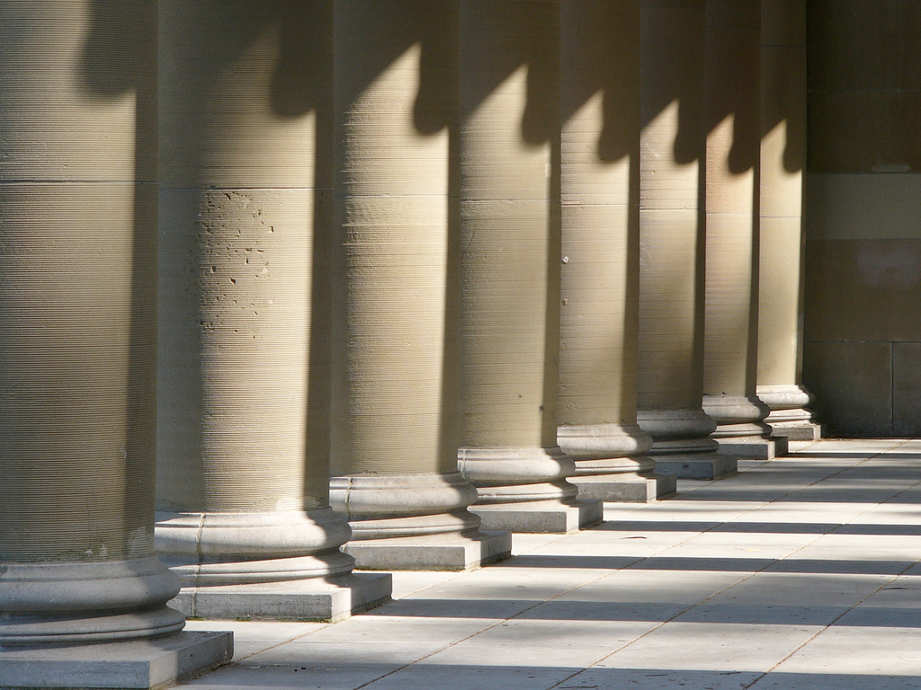

Why I Am Not An Atheist
Dr. Andy Bannister
www.rzim.ca | twitter.com/andygbannister | facebook.com/andygbannister

Slide 3
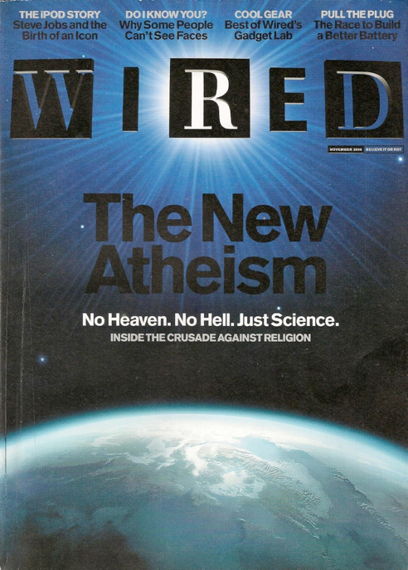
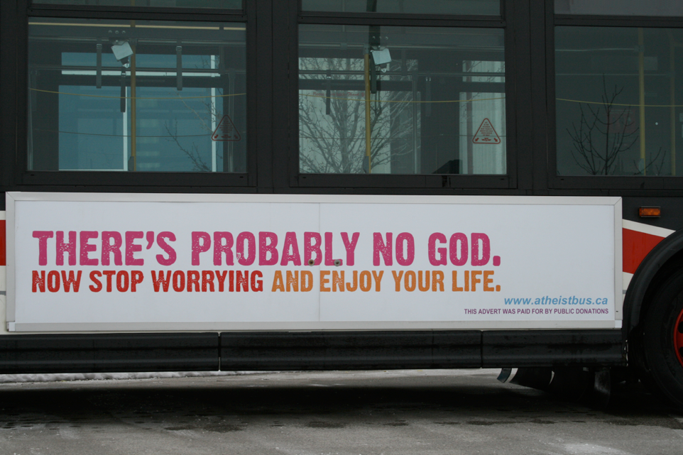

Slide 4
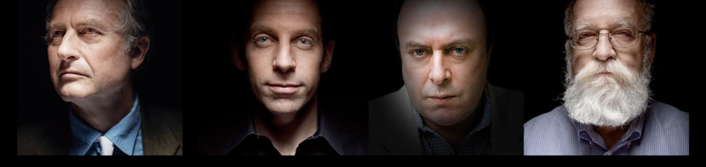

Slide 5
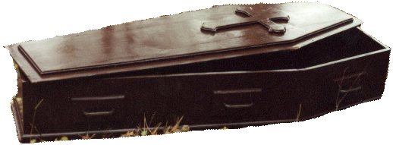
Rumours of God’s death have
been greatly exaggerated

Slide 6
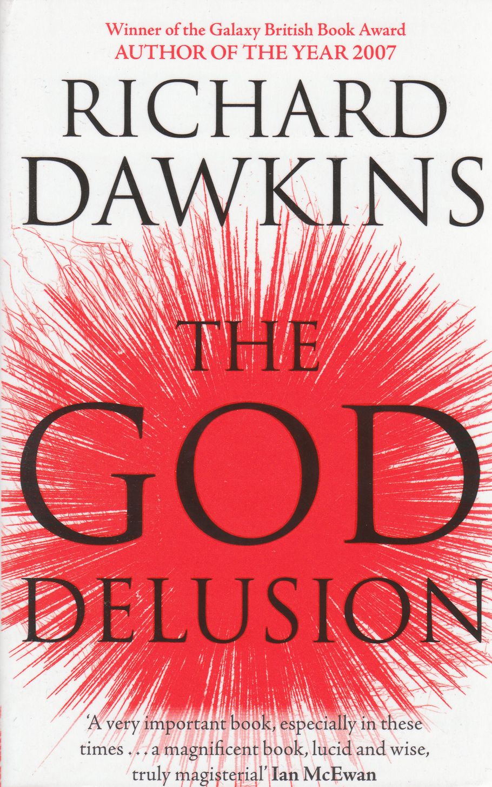

Slide 7

What is Atheism?

Slide 8
Our belief is not a belief.
- Christopher Hitchens

Slide 9
“Atheism isn’t a claim. It’s just non-belief in the claim ‘There is a god.’”

Slide 11
Atheism functions as an identity marker

Slide 13

Atheism is a belief system as much as any other worldview

Slide 14
“Atheism is a religion of sorts, or can be. Many atheists are quite religious, holding their views about God with the conviction of zealots and evangelizing with verve … It stands at the center of their lives, defining who they are, how they think, and with whom they associate. The question of God is never far from their minds.”
Stephen Prothero
(Boston University)

Slide 15
“Religion: a unified system of beliefs and practices relative to sacred things.”
Émile Durkheim

Slide 16
Four ‘Ultimate’ Questions
Origin
Meaning
Morality
Destiny

Slide 17
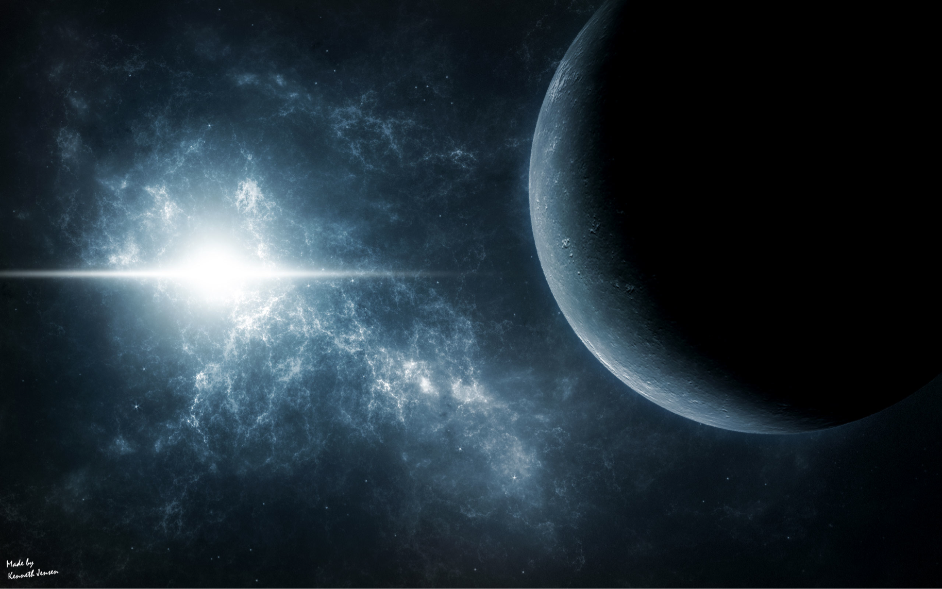
Origins

Slide 18
“Mankind is the cosmic orphan. We’re the only creature that asks ‘why?’”
Loren Eiseley

Slide 19
“[B]ecause there is a law such as gravity, the Universe can and will create itself from nothing.”
Stephen Hawking

Slide 20
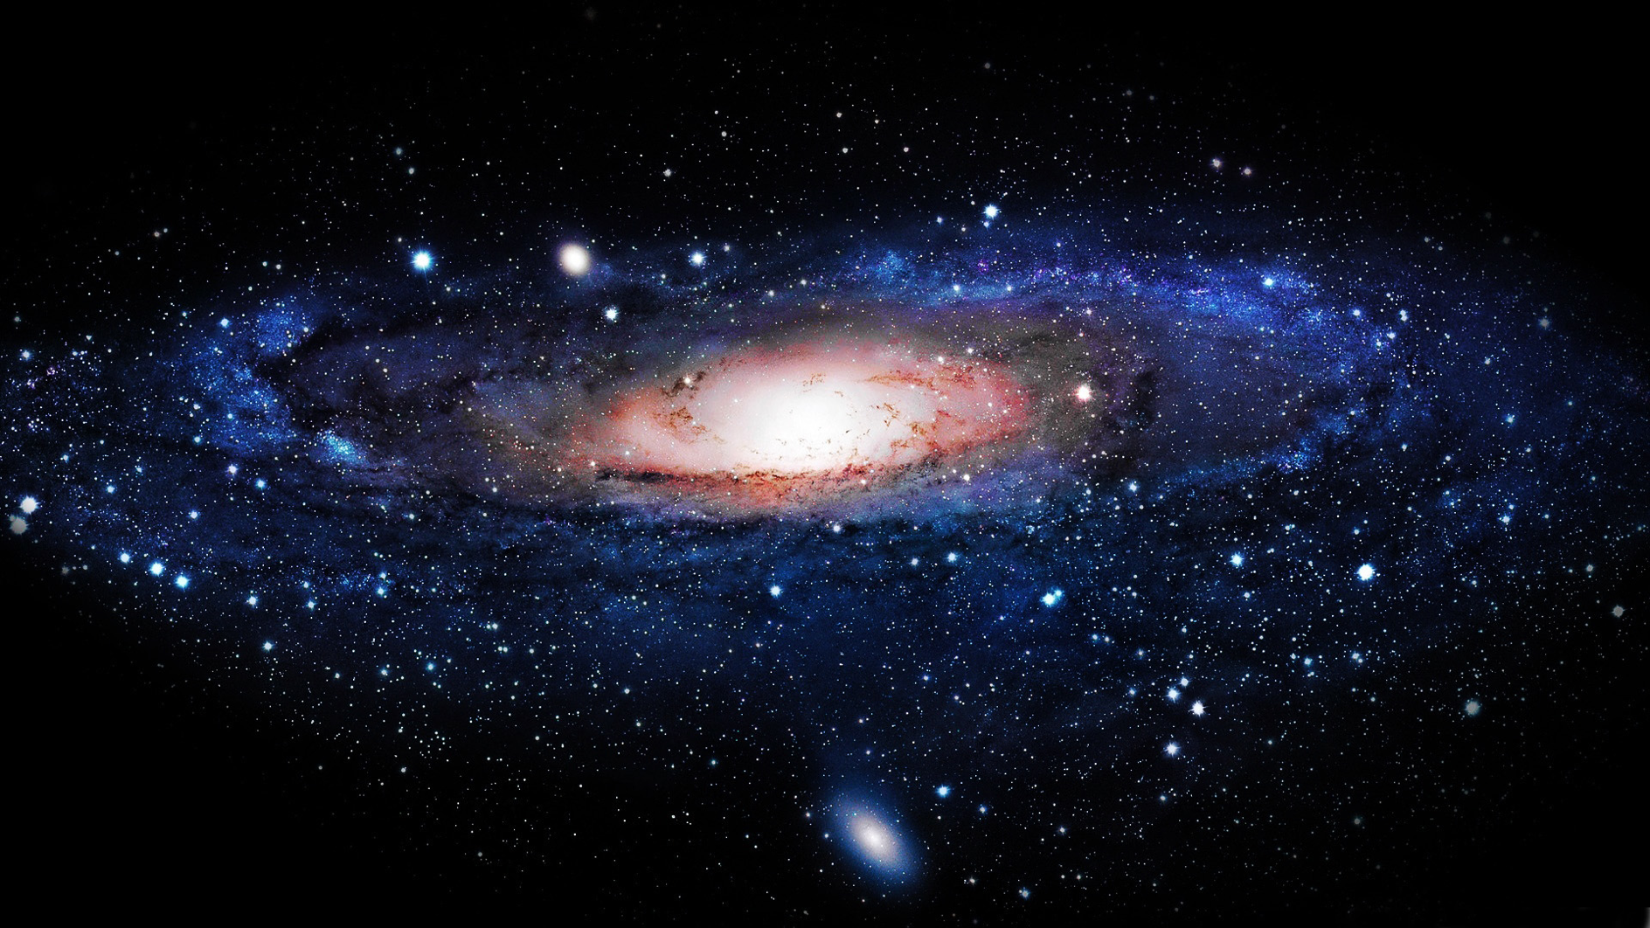

Slide 21
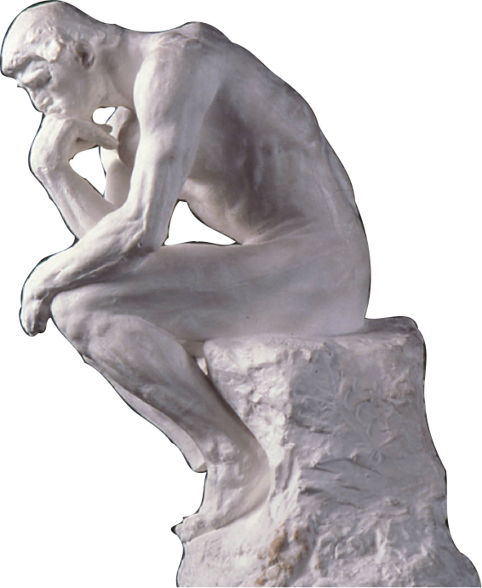

Slide 22
“With me the horrid doubt always arises whether the convictions of man’s mind, which has been developed from the mind of the lower animals, are of any value or at all trustworthy. Would any one trust in the convictions of a monkey’s mind, if there are any convictions in such a mind?”
Charles Darwin

Slide 23
“If my mental processes are determined wholly by the motions of atoms in my brain, I have no reason to suppose that my beliefs are true. They may be sound chemically, but that does not make them sound logically.”
J. B. S. Haldane

Slide 24
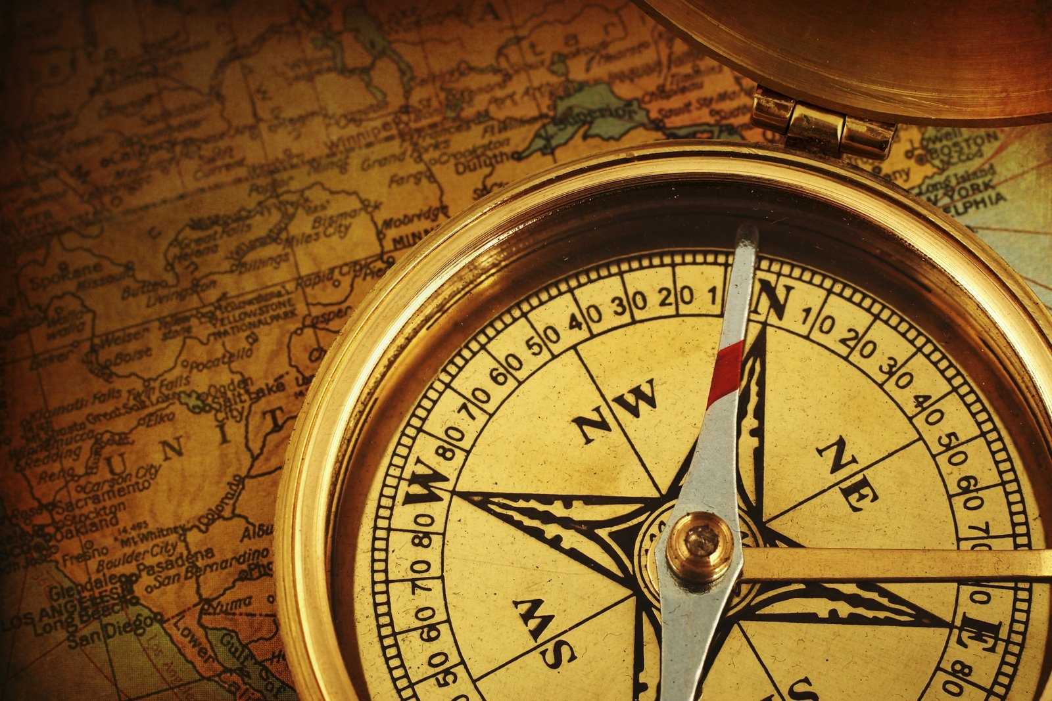
Meaning

Slide 25


Slide 27
“A man said to the universe:
‘Sir, I exist!’
‘However,’ replied the universe.
‘The fact has not created in me
A sense of obligation.’”
Stephen Crane

Slide 28
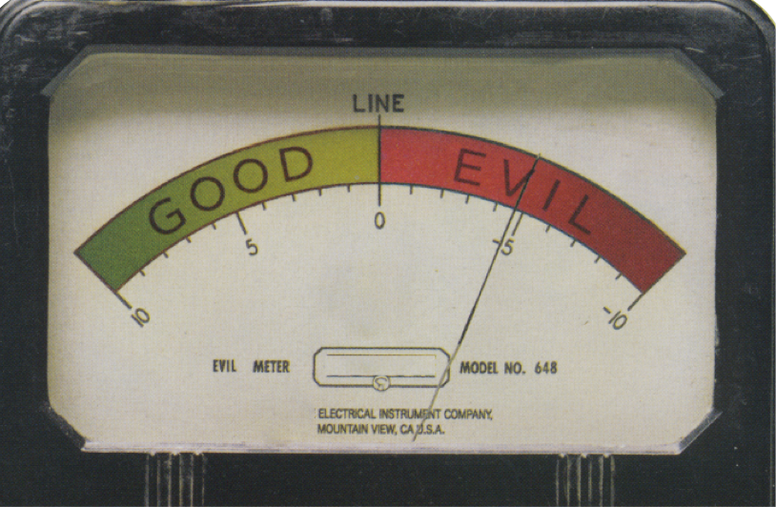
Morality

Slide 29
“The universe we observe has precisely the properties we should expect if there is, at bottom, no design, no purpose, no evil, no good, nothing but blind, pitiless indifference.”
Richard Dawkins

Slide 30
“Pure practical reason, even with a good knowledge of the facts, will not get you to morality.”
Kai Nielson

Slide 31
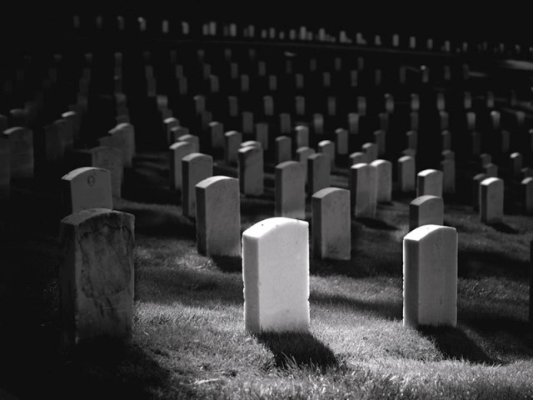
Destiny

Slide 32
“Our hopes and fears, our loves and beliefs, are but the outcome of accidental collocations of atoms; that no fire, no heroism, no intensity of thought and feeling, can preserve an individual life beyond the grave; that all the labours of the ages, all the devotion, all the inspiration, all the noonday brightness of human genius, are destined to extinction in the vast death of the solar system, and that the whole temple of Man’s achievement must inevitably be buried beneath the debris of a universe in ruins.”
Bertrand Russell

Slide 33
“If there is no God, everything is permissible.”
Fyodor Dostoevsky

Slide 34
Ideas Have Consequences

Slide 35
“A rat is a pig is a dog is a boy. They are all mammals.”
Ingrid Newkirk

Slide 36
“When one gives up the Christian faith, one pulls the right to Christian morality out from under one’s feet. This morality is by no means self-evident: this point has to be exhibited again and again, despite the English flatheads. Christianity is a system, a whole view of things thought out together. By breaking one main concept out of it, the faith in God, one breaks the whole: nothing necessary remains in one’s hands.”
Friedrich Nietzsche
“The line between good and evil runs right through the middle of every human heart.”
Aleksandr Solzhenitsyn

Slide 37
The ultimate test of a worldview: can you live it out?

Slide 38
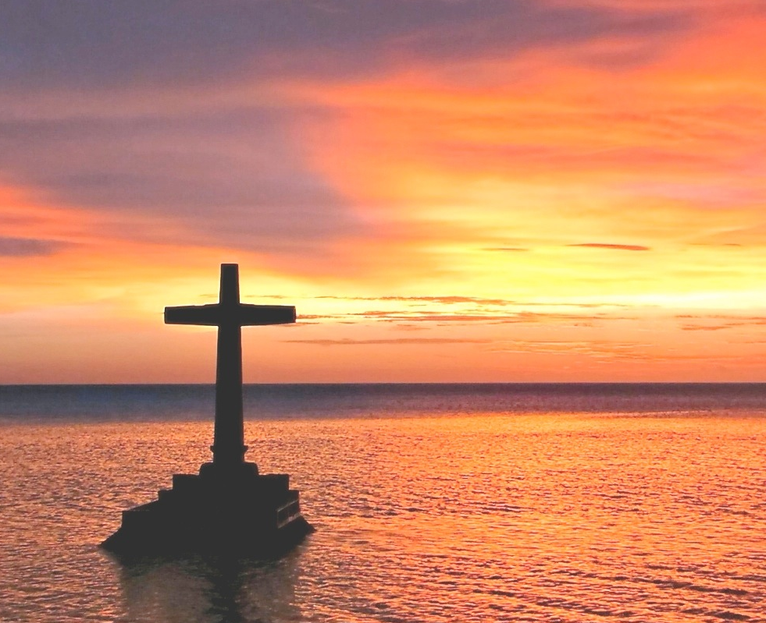
In the person of Jesus,
God came looking for us

Slide 39
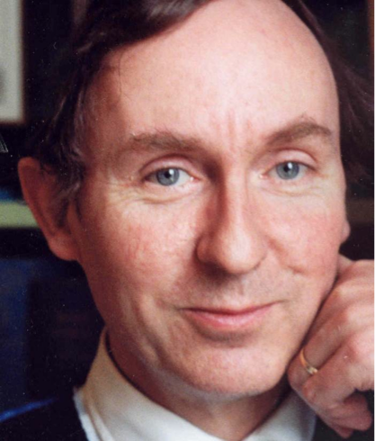
“When I think about atheist friends, including my father, they seem to me like people who have no ear for music, or who have never been in love. It is not that (as they believe) they have rumbled the tremendous fraud of religion - prophets do that in every generation. Rather, these unbelievers are simply missing out on something that is not difficult to grasp. Perhaps it is too obvious to understand; obvious, as lovers feel it was obvious that they should have come together, or obvious as the final resolution of a fugue.”
A. N. Wilson
A. N. Wilson

Slide 40
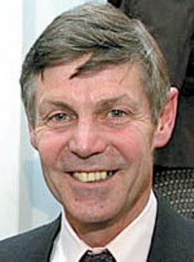
“Travelling in Malawi refreshed another belief, too: one I’ve been trying to banish all my life, but an observation I’ve been unable to avoid since my African childhood. It confounds my ideological beliefs, stubbornly refuses to fit my worldview, and has embarrassed my growing belief that there is no God. Now a confirmed atheist, I’ve become convinced of the enormous contribution that Christian evangelism makes in Africa … In Africa, Christianity changes people’s hearts. It brings a spiritual transformation. The rebirth is real. The change is good.”
Matthew Parris
Matthew Parris

Slide 41
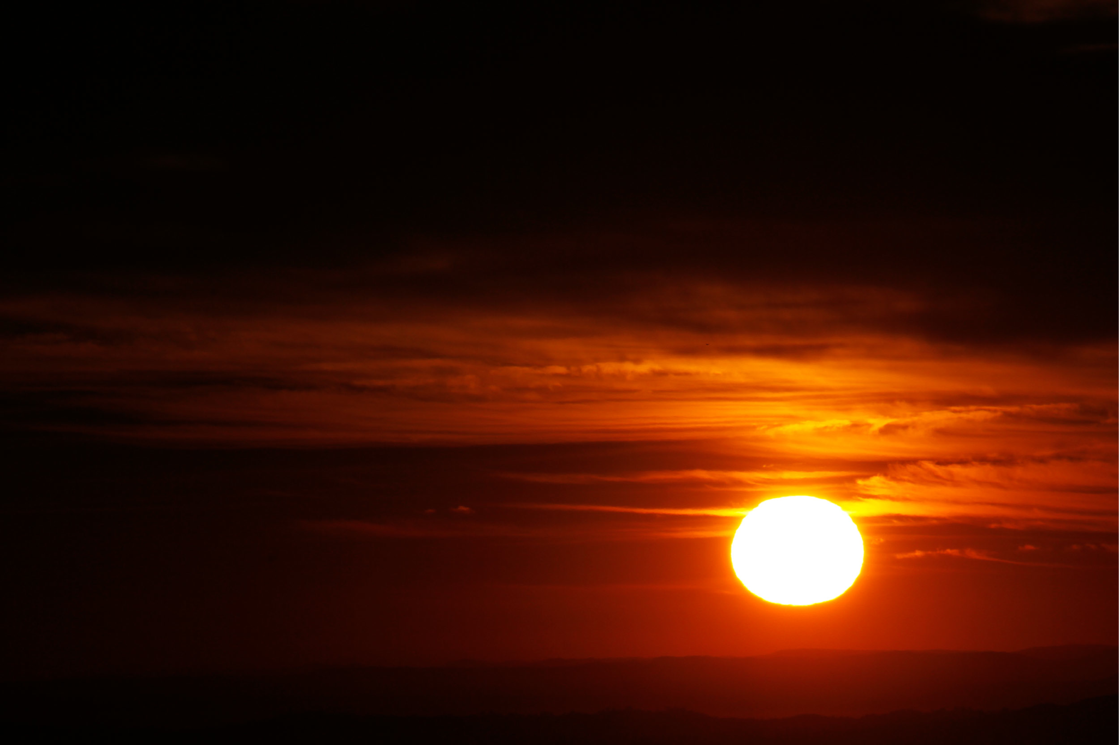
“I believe in Christianity in the same way that I believe the sun has risen. Not only because I see it, but because by it, I see everything else.”
C. S. Lewis

Slide 42
www.rzim.ca
@andygbannister
facebook.com/andygbannister
www.burningquestions.ca

